Slide 1


BEYOND THE GRID:
CLEAN HYDROGEN PATHWAYS FOR DATA CENTRES
Bord Gáis
Dublin
10th September 2026

Slide 2
AGENDA
Future Pathways: Hybrid Models and Global Hydrogen Lessons
Paul McCormack, CEO Hydrogen Ireland
The Grid Dependency Challenge for Data Centres
Jean‑Yves Cherruault, Centrica
Welcome
John Dalton, Country Manager, Bord Gáis Energy
Storage, Flexibility, and Backup Through Hydrogen Peter Lantry, Equinix
Networking/Lunch
11:00
11:25
11:55
12:25
13:00
11:10
11:40
12:10
12:40
Introduction Opening remarks
Cynthia Ní Mhurchú MEP
Hydrogen as on‑Site Generation: Microgrids and Autonomy
Keith MacLean‑Martin, Piller Power Systems
Policy, Economics, and Market Signals for Hydrogen Adoption
Agnes Warner, Pure DC
Q&A

Slide 3

WELCOME
John Dalton, Country Manager, Bord Gáis Energy

Slide 4
WELCOME
Hosted by Bord Gáis Energy,
This webinar will explore how clean hydrogen microgrids can support resilient, sustainable data‑centre growth and reduce dependence on constrained grid capacity.
This webinar forms part of Hydrogen Ireland’s coordinated programme of webinars, workshops, and their annual conference, H2 Summit - Hydrogen Ireland developed to align with Ireland’s Presidency of the Council of the European Union (July–December 2026). Through this series, Hydrogen Ireland aims to mark this milestone and amplify Ireland’s hydrogen leadership and message to a global audience.
Notes:
Mirroring Northern Ireland’s experience and is echoed across parts of Europe.

Slide 5
THREE AUDIENCE PRIMERS TO SET THE TONE
1. What happens when data‑centre growth outpaces the grid?
  Hydrogen offers a new pathway for expansion when traditional electricity supply can’t keep up.
2. Can we replace diesel backup without compromising reliability?
  Clean hydrogen provides a zero‑emission alternative that still meets the resilience standards operators depend on.
3. Are data centres destined to be grid‑dependent forever?
  Hydrogen microgrids open the door to energy independence, flexibility, and new operating models.

Slide 6

CYNTHIA NÍ MHURCHÚ MEP
Cynthia Ní Mhurchú is a first-time Fianna Fáil MEP representing Ireland South and a member of Renew Europe Group, the centrist political group in the European Parliament

Slide 7
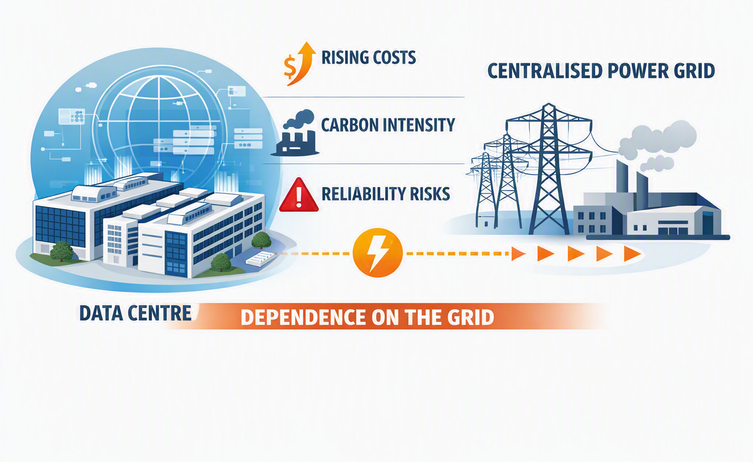
CRITICAL DIGITAL INFRASTRUCTURE
Data centres are critical digital infrastructure, yet their reliance on centralised grids exposes them to rising costs, carbon intensity, and reliability risks. This webinar will examine the challenge and discuss how clean hydrogen can become a potential pathway to reduce dependence while enhancing resilience.
Questions we’ll explore today
  Exploring Clean Hydrogen Microgrids for Sustainable Data Centres
  Reliance on the Grid: Is There Another Way?

Slide 8
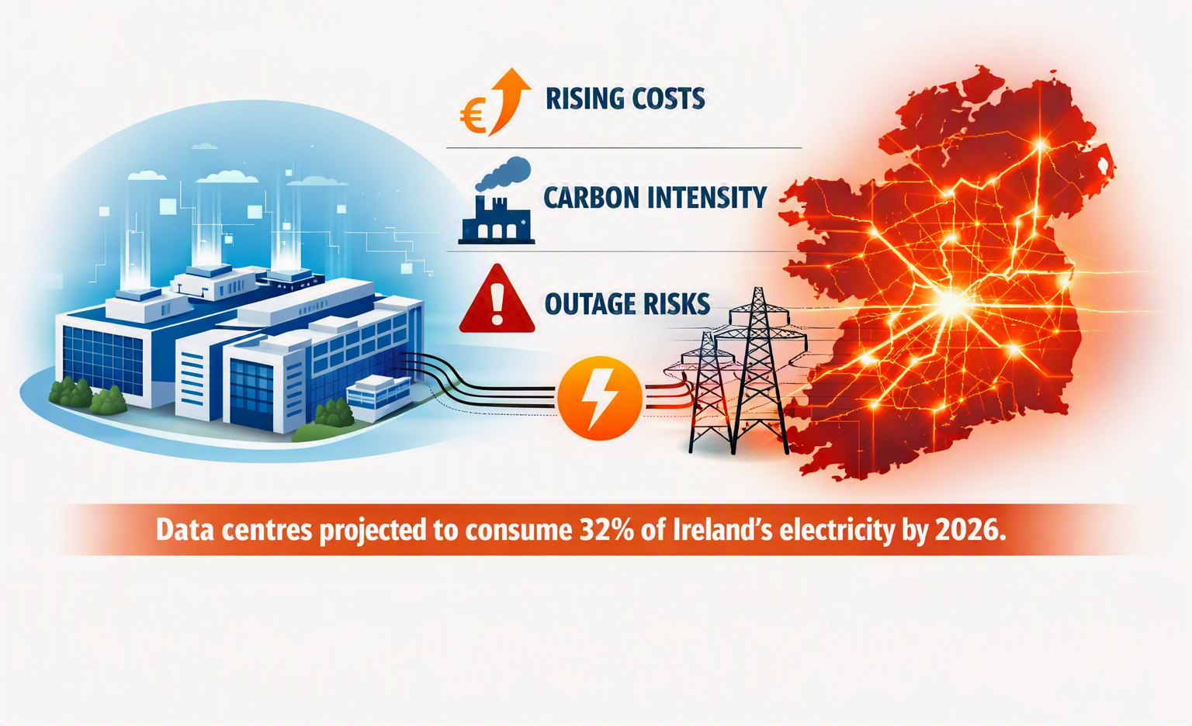
ELECTRICITY DEMAND
Data centres consume vast amounts of electricity, often straining national grids. In Ireland, for example, data centres are projected to account for 32% of national electricity demand by 2026.
This dependency creates risks:
  rising costs,
  carbon intensity,
  and vulnerability to outages.

Slide 9
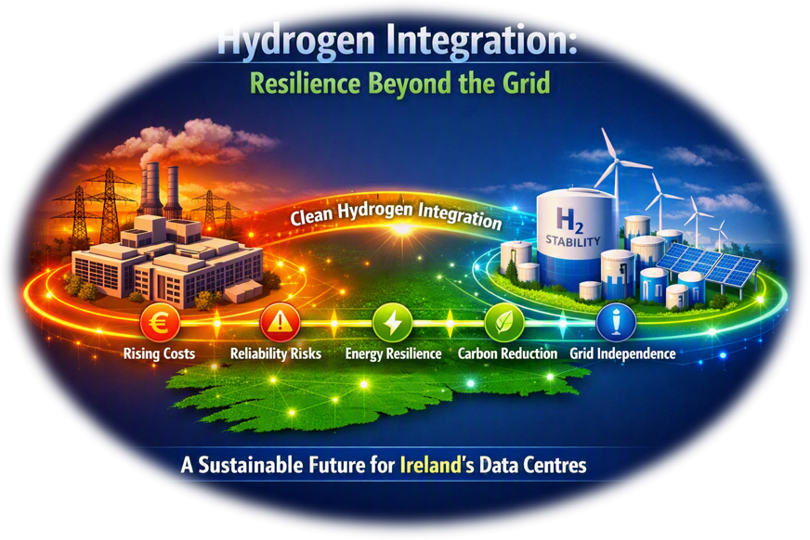
PATHWAY TO RESILIENCE
Hydrogen offers a pathway to resilience. By reframing the challenge around autonomy and sustainability, hydrogen can reduce reliance on the grid while aligning with decarbonization goals.
Microsoft’s pilot project in Dublin, which powered a data centre building with 250kW of green hydrogen fuel cells, demonstrates how hydrogen can directly substitute for diesel backup systems

Slide 10

ENERGY CROSSROADS
Ireland’s data centre sector is at a crossroads. As these facilities now account for roughly 21% of the nation’s electricity usage (with operational capacity at 1.4 GW and set to rise to 2.6GW by 2030) their dependence on the centralised grid is becoming a strategic risk.
Grid reliance exposes operators to escalating energy costs, connection backlogs, and growing concerns over supply reliability, especially as Ireland’s electricity demand is forecast to increase by 45% by 2034. The current grid mix (43% fossil fuels, 42% low-carbon sources, and 15% imports) means that data centres are vulnerable to price volatility, emissions targets, and potential supply disruptions.

Slide 11

OUR INTERDEPENDENT ENERGY‑DIGITAL ECOSYSTEM
The future of digital infrastructure and the future of the grid are now inseparable. Their shared success depends on coordinated action, diversified energy strategies, and a commitment to building a secure, sustainable, and interdependent energy‑digital ecosystem

Slide 12
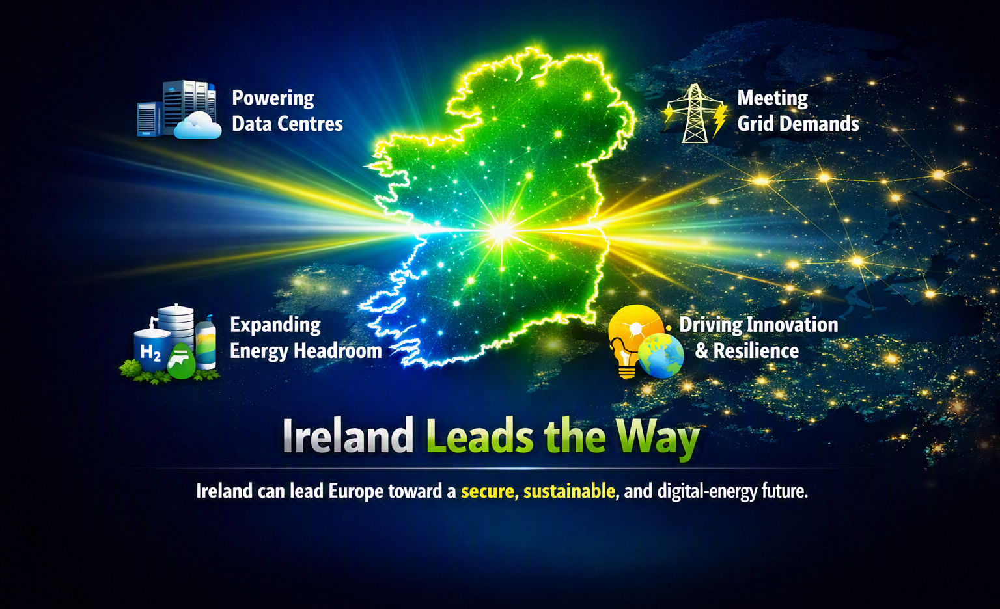
WHERE DIGITAL AND ENERGY CONVERGE TO SHAPE EUROPE’S TOMORROW
Ireland can set the European benchmark for how to power data‑centre growth without overwhelming the electricity system.
Smart grid management and diversified energy strategies allow Ireland to meet rising digital demand while strengthening national resilience.
Hydrogen, storage, and flexible generation create the technological and energy headroom needed for long‑term digital expansion.
Coordinated action between regulators, grid operators, and industry can turn today’s constraints into tomorrow’s competitive advantage.
By proving that digital growth and decarbonisation can reinforce each other, Ireland positions itself to lead Europe toward a secure, sustainable, and interdependent energy‑digital future.
Notes:
This is not a speculative hydrogen vision. This is a practical system architecture that starts with curtailed wind, begins with resilience and backup, and scales into deeper system integration as hydrogen markets mature.
Surplus wind feeds electrolysis via private wire.
Hydrogen is stored and later converted back to power through fuel cells to support data centre operations, with optional grid interaction for resilience and market optimisation.
Grid is repositioned correctly
The grid is now shown as:
supportive, not dominant
a source of resilience and arbitrage
a beneficiary of flexibility and balancing
This visually reinforces the shift from grid load → grid asset.

Slide 13

JEAN‑YVES CHERRUAULT
Dr Jean-Yves Cherruault
Head of Group Strategic Partnerships at Centrica

Slide 14

centrica
Beyond the Grid
Clean Technologies Pathways for Data Centres
Hydrogen Ireland Webinar | 10 September 2026 | Dr Jean-Yves Cherruault, Centrica
1
centrica
Notes:
OPENING — my segment: The Grid Dependency Challenge for Data Centres.
- Thank the chair and Hydrogen Ireland / Bord Gais for hosting; acknowledge this sits within Ireland's EU Presidency programme.
- Frame the 15 minutes: Ireland's data centre sector is at a crossroads; grid dependency has become the binding constraint on growth. My aim is to reframe that constraint as an opportunity — clean, self-generated power.
- Set up the arc: (1) where we are, (2) why it matters economically, (3) the energy trilemma, (4) the proven formula to unlock it.
- Keep it upbeat and opportunity-led — I'm here to excite the room about what the challenging context makes possible, not to dwell on the problem.
- Note I'm speaking as Centrica / Bord Gais — the incumbent energy partner already working with operators on on-site solutions.
[~2 min]

Slide 15
Ireland’s data centre sector at a crossroads
Grid dependency has become a strategic risk and a catalyst for change
22%
1.4→2.6 GW
+30%
of Ireland’s electricity is used by data centres today — up from just 5% in 2015
operational capacity today, set to rise to 2.6 GW by 2030 as demand accelerates
forecast rise in Ireland’s national electricity demand by 2032
December 2025: The regulatory turning point
The CRU’s new Large Energy User policy ends the connection moratorium in place since 2021. New data centres must now self-supply generation and storage matching their demand, and meet 80% of annual demand with new Irish renewables within six years. Growth is no longer about the grid, it is about clean, self-generated power.
2
centrica
Notes:
SLIDE 2 — Where we are.
- Lead with the headline shift: data centres now use ~22% of Ireland's electricity, up from just 5% in 2015 — a four-fold rise in a decade. No other advanced economy is this concentrated.
- Capacity is ~1.4 GW today, heading to ~2.6 GW by 2030; national demand is forecast up ~45% by 2034. The grid simply cannot keep pace.
- The pivot point is December 2025: the CRU's new Large Energy User policy ended the connection moratorium that had effectively frozen new grid connections since 2021.
- The trade-off: new data centres must now self-supply generation and storage matching demand, and meet 80% of annual demand with NEW Irish renewables within six years.
- KEY MESSAGE to land: growth is no longer about waiting for the grid — it is about clean, self-generated power. That is the opportunity this webinar is about.
- Source: Section 1 report / CRU LEU policy.
[~3 min]

Slide 16
A powerful engine for Ireland’s economy
Data centres already underpin billions in value and constrained capacity means lost opportunity
€21bn
~69,000
€428m
annual contribution to Ireland’s GVA from data-centre customers’ activity around 4% of national GVA
jobs supported across the economy through data-centre customers’ activity
GVA from a single operator’s 10-year Irish capital pipeline (Equinix)
But capacity is the constraint
Globally, an estimated Hundred bn Euros of demand goes unfulfilled every year for lack of data centre capacity. Every gigawatt Ireland cannot power is investment, revenue and jobs lost to other markets, making new capacity a national economic priority.
3
centrica
Notes:
SLIDE 3 — Why it matters economically.
- Data centres are not a niche — the activity they enable contributes ~EUR 21bn a year to Ireland's GVA, roughly 4% of the national economy, and supports ~69,000 jobs across the wider economy (Equinix/KPMG customer-base analysis).
- Scale it to one operator: Equinix's announced 10-year Irish capital pipeline alone generates ~EUR 428m in GVA — a sense of how much sits behind a single player.
- The flip side is the cost of NOT building: globally ~USD 350bn of demand goes unmet every year for lack of capacity.
- Make it national: every gigawatt Ireland cannot power is investment, revenue and jobs lost to competing markets — so new, clean capacity is a national economic priority, not just an operator problem.
- Attribution note: these are Equinix/KPMG figures — credit them, especially as Peter Lantry (Equinix) is on the panel.
- Source: ip_kpmg_report_equinix_ireland_gdp.
[~3 min]

Slide 17
Answering the energy trilemma
New, renewable and sovereign energy is the key that unlocks the sector’s growth
Energy security
Carbon
Cost
Reliable, always-on power that reaches beyond a constrained grid, resilience by design, not by chance.
An 80% renewables obligation and clean hydrogen delivering ≥70% lifecycle GHG savings versus fossil fuels.
Affordable, predictable energy that keeps Ireland competitive against other European data-centre hubs.
Sovereignty of supply is now strategic
Clean hydrogen or other technologies microgrids and on-site generation offer autonomy, resilience and sustainability, turning today’s grid constraint into tomorrow’s competitive advantage.
4
centrica
Notes:
SLIDE 4 — The energy trilemma.
- Any solution has to answer three things at once: security, carbon and cost. Miss one and it doesn't fly.
- Energy SECURITY: reliable, always-on power that reaches beyond a constrained grid — resilience designed in, not left to chance.
- CARBON: the 80% renewables obligation plus clean hydrogen delivering >=70% lifecycle GHG savings vs fossil fuels — this keeps operators compliant and on their net-zero paths.
- COST: affordable, predictable energy so Ireland stays competitive against other European hubs — cost is where many alternatives fall down.
- The strategic twist to land: SOVEREIGNTY of supply. Clean hydrogen microgrids and on-site generation give autonomy, resilience and sustainability — turning today's grid constraint into tomorrow's competitive advantage.
- This is Centrica / Bord Gais's space — design, finance, build and operate on-site solutions. Hand smoothly to the hydrogen speaker on microgrids and to Peter (Equinix) on storage/backup.
- Source: Data Centre Energy Summit report / DataCentres Ireland takeaways.
[~3 min]

Slide 18
A proven formula for delivery
Align capital, policy and industrial know-how — it has worked before
Patient capital
Policy & politics
Industrial know-how
De-risked, long-term financing at scale, public backing that unlocks private investment.
Stable, aligned government direction on planning, regulation and renewable connection.
Domestic supply chains, skills and delivery capability rooted in local communities.
Proven at scale: France’s Messmer Plan took nuclear from 8% to ~80% of supply in ~15 years, the London Underground and US Interstates tell the same story. And the industrial dividend is already visible in Ireland: Equinix’s ~€593m advanced manufacturing facility in Dundalk (14,000 m²) will build power equipment for data centres and support ~200 skilled jobs, with ~€153m of GVA from two Dublin builds, and every 10 direct jobs supporting ~3 more across the supply chain.
The prize is bigger than data centres
Get the alignment right and Ireland does more than power its data centres — it revitalises its wider industrial base, its domestic supply chains and the skilled jobs and communities that come with it.
5
centrica
Notes:
SLIDE 5 — The proven formula, and the bigger prize (CLOSE).
- The unlock is an alignment of three things: patient capital (de-risked, long-term, public backing that crowds in private money), aligned policy & politics (planning, regulation, renewable connection), and domestic industrial know-how (supply chains, skills, local delivery).
- We've done this before: France's Messmer Plan took nuclear from 8% to ~80% of supply in about 15 years; the London Underground and the US Interstate system are the same story of capital + policy + industry aligned behind national infrastructure.
- INDUSTRIAL / JOBS EVIDENCE to emphasise: this isn't theoretical for Ireland. Equinix's ~EUR 593m long-term agreement with Hanley Energy is funding a 14,000 m2 advanced manufacturing facility in Dundalk that will make specialised power equipment for data centres and AI, supporting ~200 skilled jobs.
- Add the multipliers: ~EUR 153m of GVA from the DB7x/DB8 Dublin builds during construction, and for every 10 direct jobs a further ~3 are supported across the supply chain and wider economy. Irish SMEs building and maintaining these sites have grown to win clients worldwide.
- CLOSE on the big message: get the alignment right and Ireland does more than power its data centres — it revitalises its wider industrial base and the skilled jobs and communities that come with it. That is the prize, and clean hydrogen is central to it.
- Hand to the next speaker (hydrogen as on-site generation).
- Sources: Comparing UK Critical Infrastructure Development (Messmer); ip_kpmg_report_equinix_ireland_gdp (Dundalk facility, GVA, jobs multiplier, SMEs).
[~4 min]

Slide 19

KEITH MACLEAN‑MARTIN
Keith MacLean‑Martin
Technical Director, Piller UK Ltd (subsidiary of Langley Power Solutions Division)

Slide 20
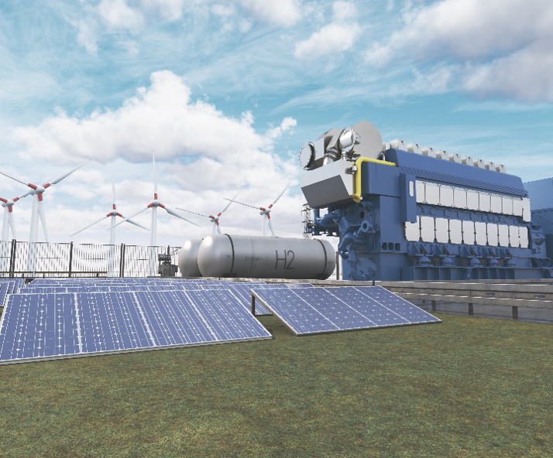
TRANSITIONAL ROLE OF ONSITE GENERATION
Data Centre Power
Critical Power Requirements
Redundancy & Resilience key
Always on Demand delivering > 99.999% Availability
Temporary Image
Data Centre Power
Critical Power Requirements
Redundancy & Resilience key
Always on Demand delivering > 99.999% Availability
Power Availability
Grid connections 5 – 10 years
Standby generation → Prime power generation
Generation delivers grid services
Fuel Road Map:
Diesel → HVO → Gas → Biomethane → Hydrogen
Power Availability
Grid connections 5 – 10 years
Standby generation → Prime power generation
Generation delivers grid services
Fuel Road Map:
Diesel → HVO → Gas → Biomethane → Hydrogen

Slide 21
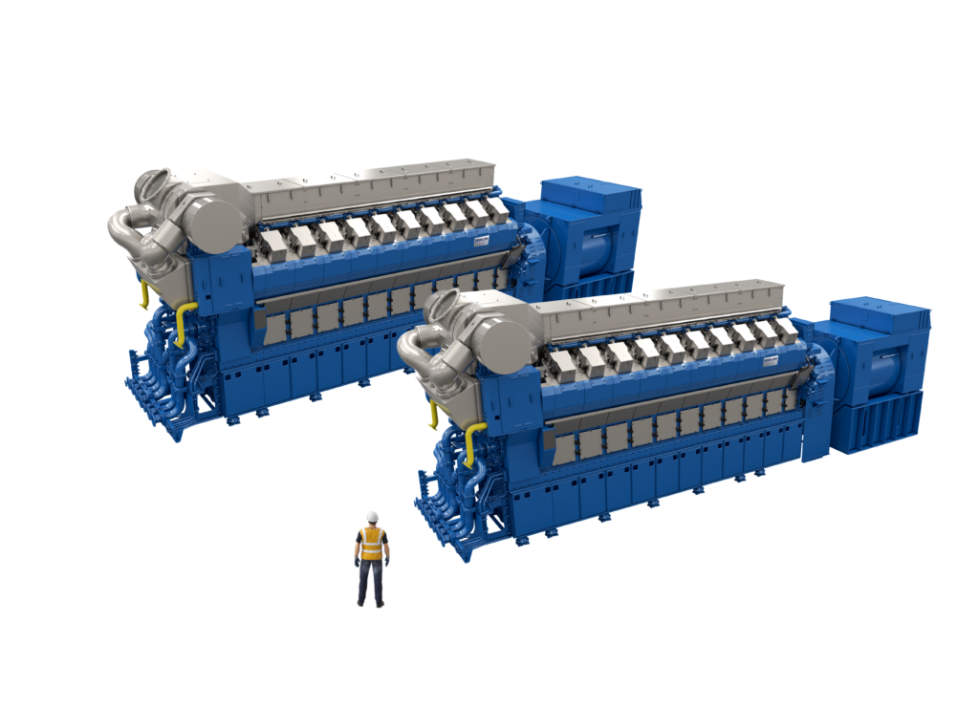
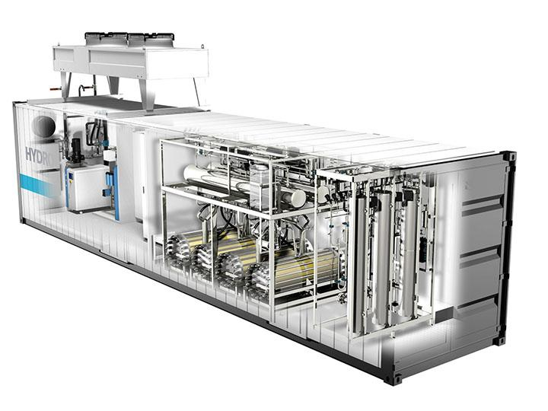
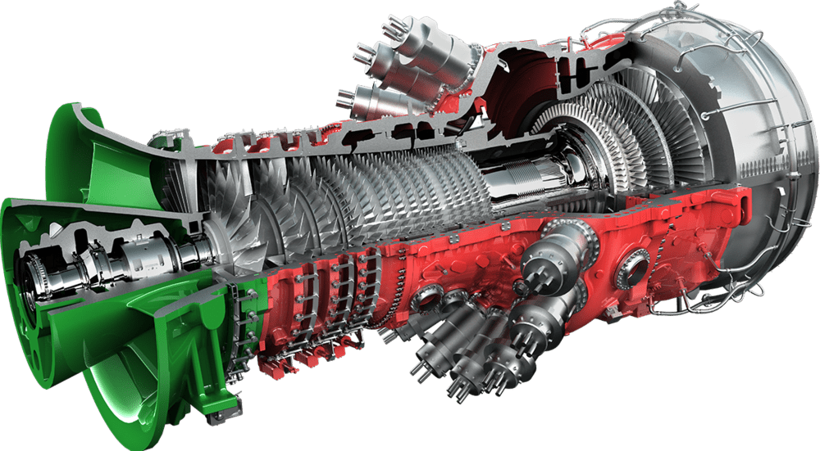
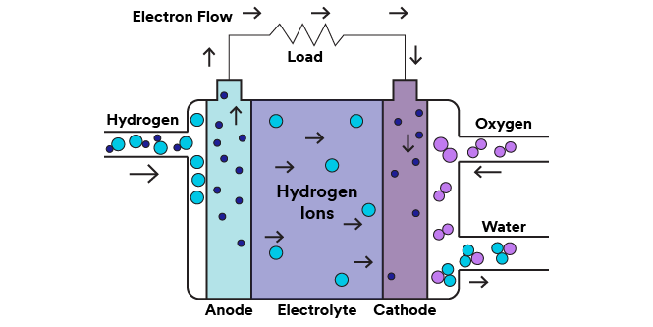
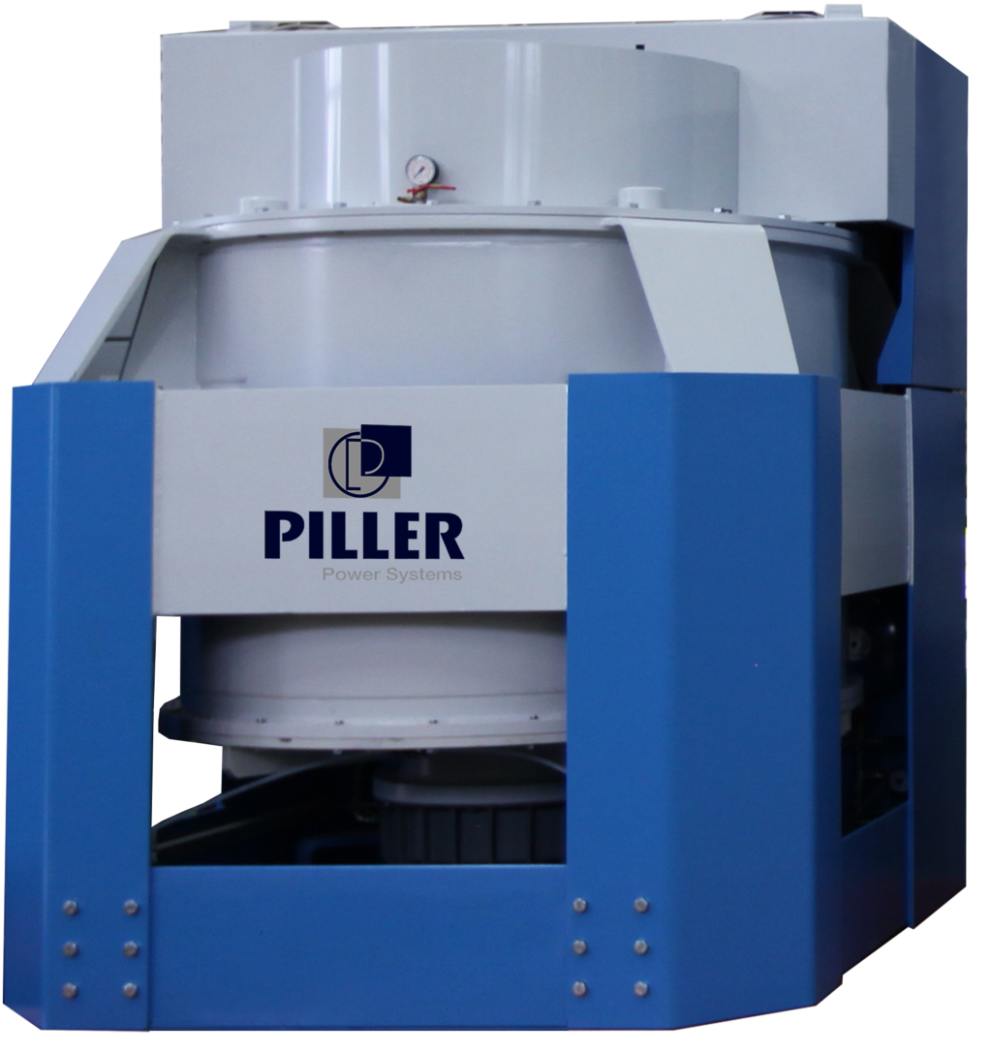
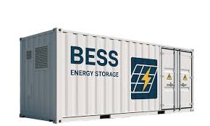
GENERATION & AUTONOMY
Reciprocating Engines
Turbines
Fuel Cells, such as
  Solid Oxide (SOFC)
  Molten Carbonate (MCFC)
  Phosphoric Acid (PAFC)
Battery Energy Storage (BESS)
Flywheel Energy Storage (FESS)
Electrolysers
Autonomy | Seconds | Minutes | Hours | Days | Weeks | Continuous
Flywheel Storage
Battery Storage
Standby Generation
Prime Generation

Slide 22
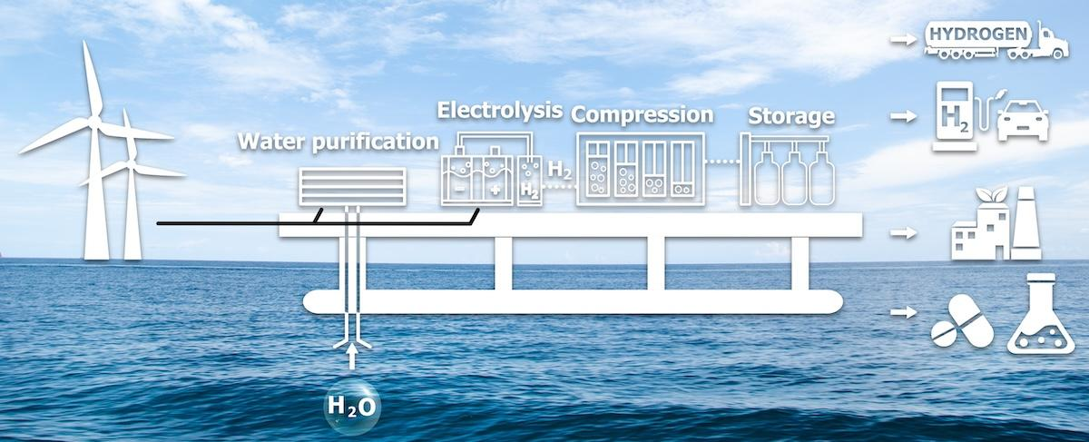
RENEWABLE ENERGY INTO DISPATCHABLE POWER
Curtailed wind generation – 2.1TWh
Electrolysis to generate Hydrogen
Local storage or pipe network transfer
Hydrogen delivered to generation
Power delivered as required
Battery Energy Storage System (BESS)

Slide 23
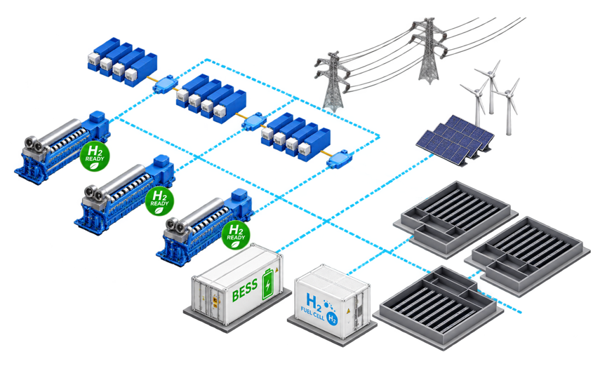
MICROGRID & AUTONOMY
UPS & Power Conditioning
Stability
Grid Forming
Power Quality
Grid Connection
Import Demand
Export Demand
Grid Services
Prime Power Generation
Despatchable Power
Grid Services
Demand
Renewable Generation
Clean Power
Produce Green H₂
Battery Energy Storage System
Medium Term Storage
Hours
Data Centre Power
Clean
Reliable & Secure
High Quality
Hydrogen Fuel Cell
Generator using Hydrogen
Grid Forming
Power Quality

Slide 24
PATHWAY AND REMAINING CHALLENGES
Data Centre Scale from 100s kW to 10s MW
  Deliver a mix of generation assets powered by different fuels
  Consider generation assets power using blended fuels delivering pathway to 100% Hydrogen
  Diverse assets helps to deliver reliability, redundancy and security
  Microgrid stability key in all operational modes and combinations of assets.
Hydrogen
  Challenges remain to scale the production; as use grows solutions evolve
  Geographic locations and transport to final point of use

Slide 25

PETER LANTRY
Peter Lantry
leads Equinix’s business in Ireland and is responsible for driving the company’s growth as Ireland’s digital economy expands in tandem with data volumes

Slide 26

Hydrogen Ireland
Storage, Flexibility, and Backup Through Hydrogen
September 2026
Peter Lantry, Managing Director, Equinix Ireland
‹#›

Slide 27
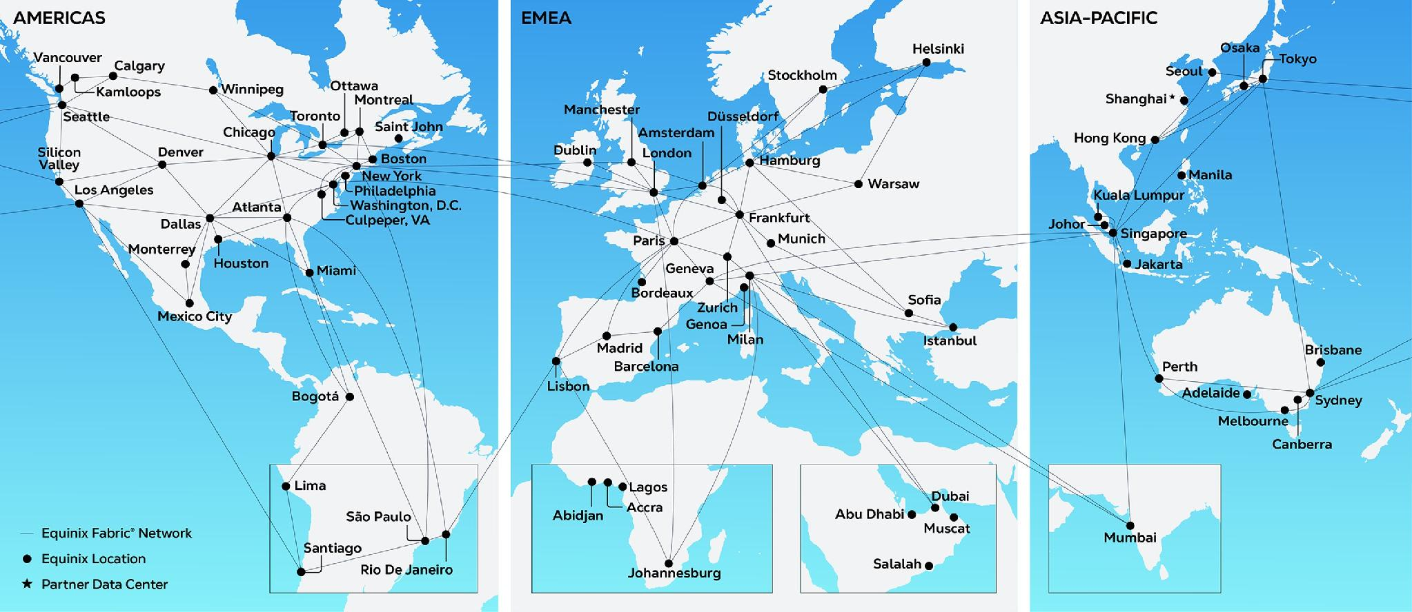
270+ | 77 | 36 | 99.999%+
Data centers | Metros | Countries | Uptime record*
The world’s digital infrastructure company®
Shortening the path to unmatched connectivity and success, enabling digital innovations that shape the world.

Slide 28

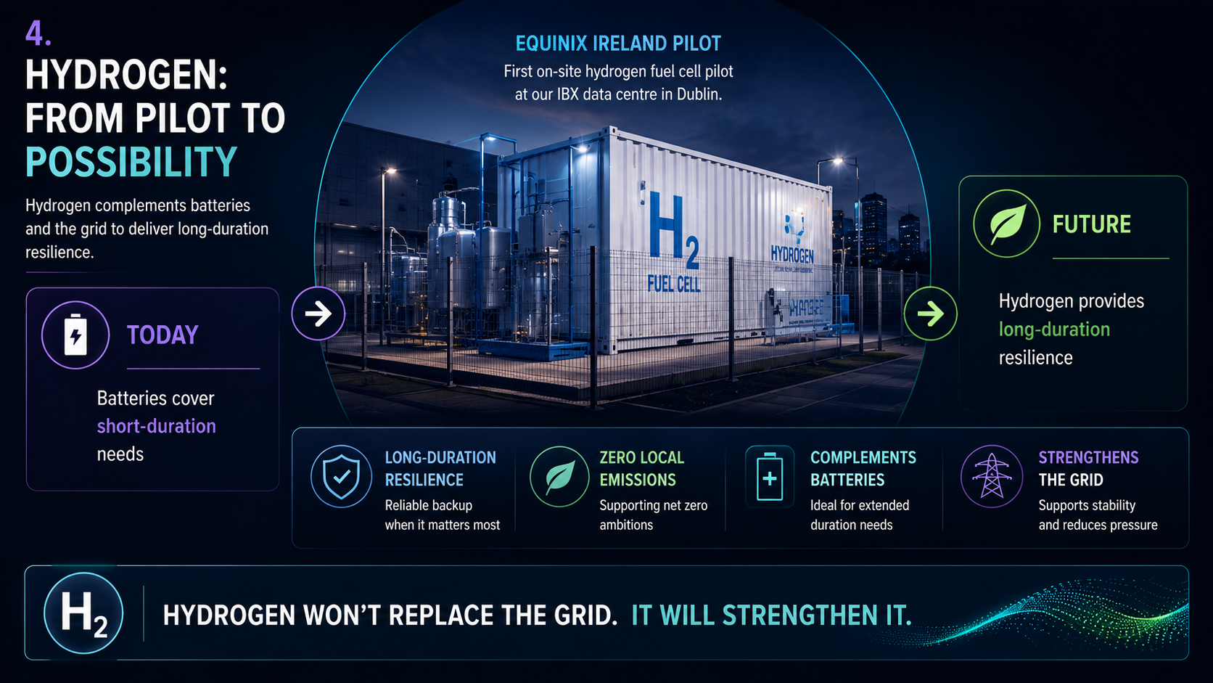
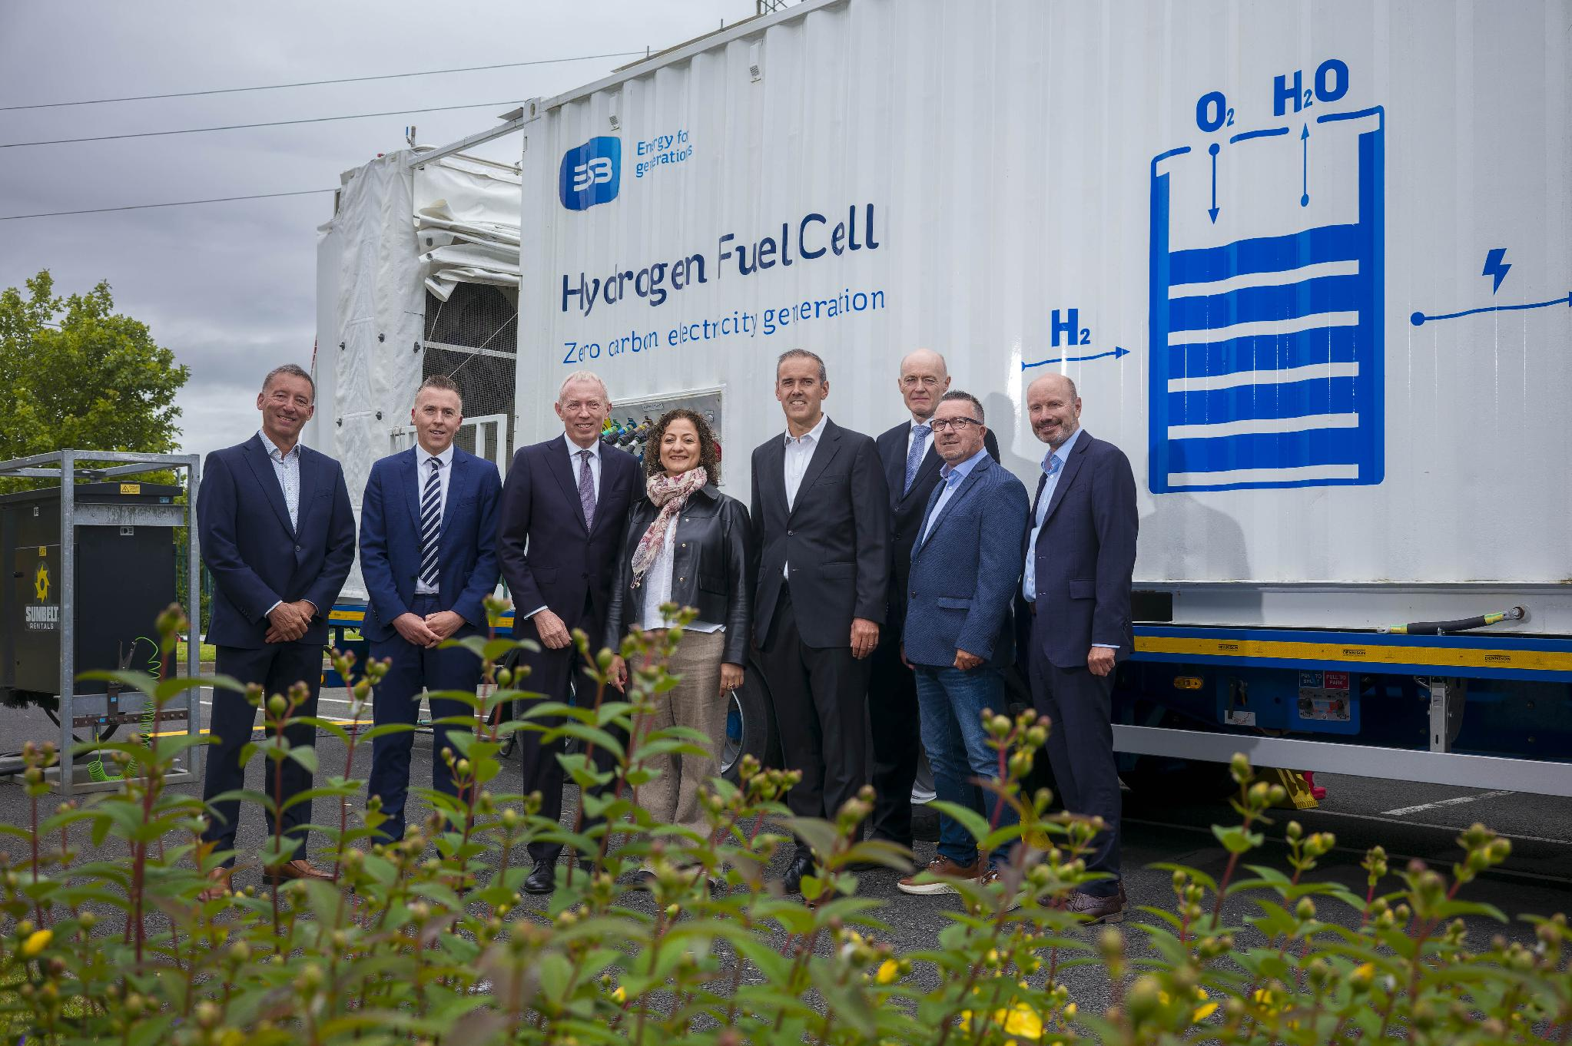

Slide 29
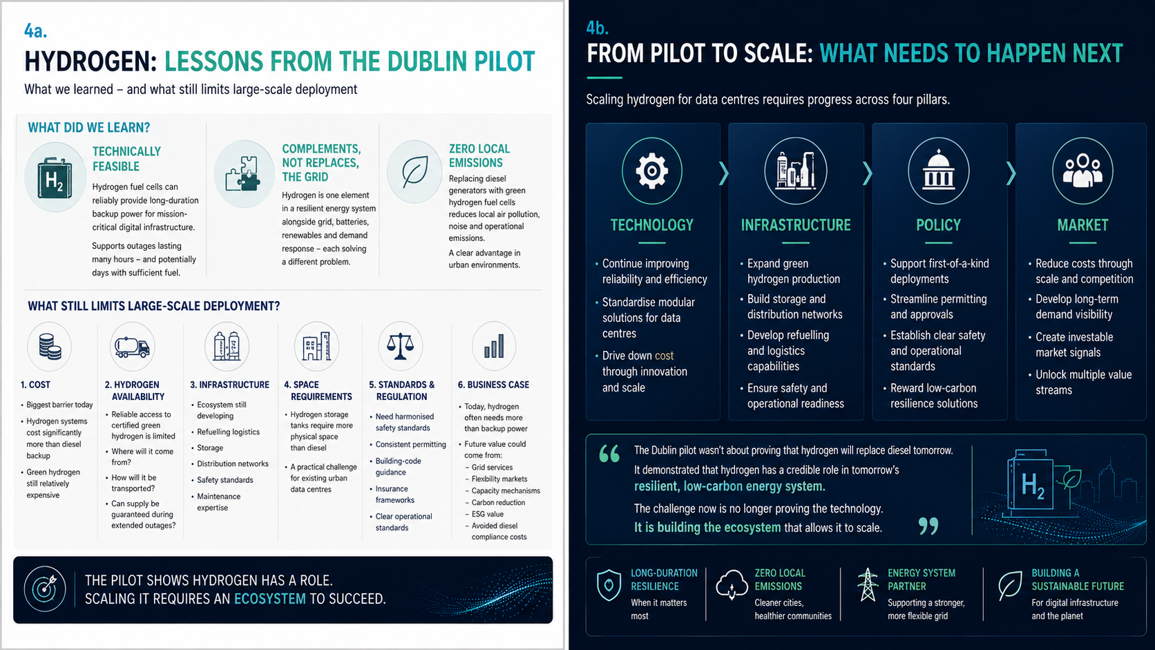

Slide 30
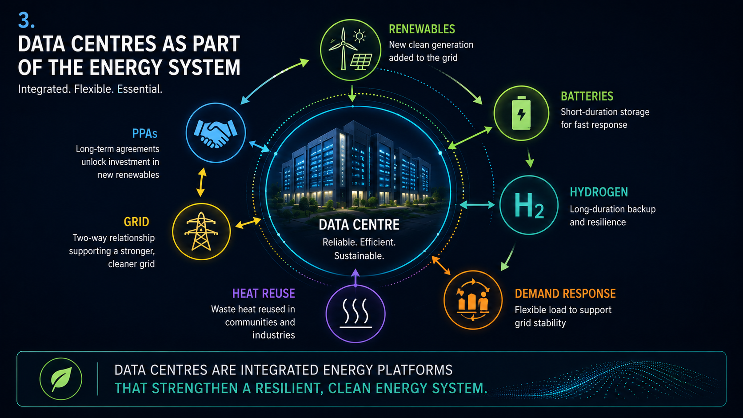
Notes:
The future is not about consuming less power – it is about accelerating the green energy transition – together!
The future data centre is no longer simply powered by the energy system – it actively helps power it!

Slide 31
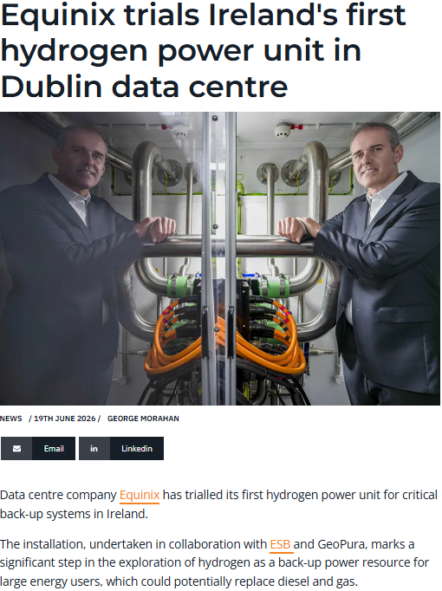
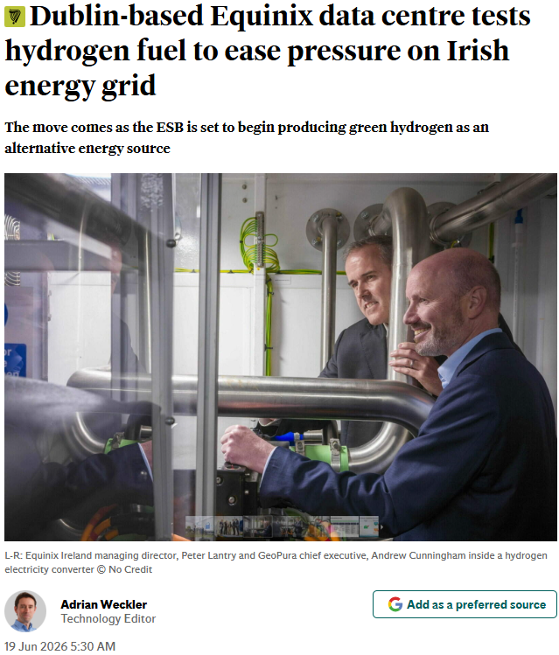
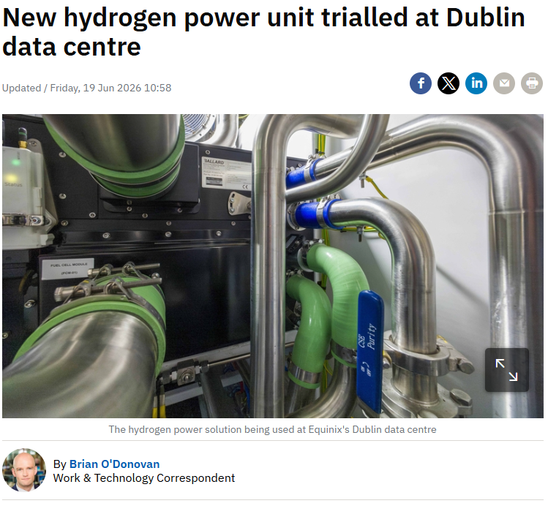
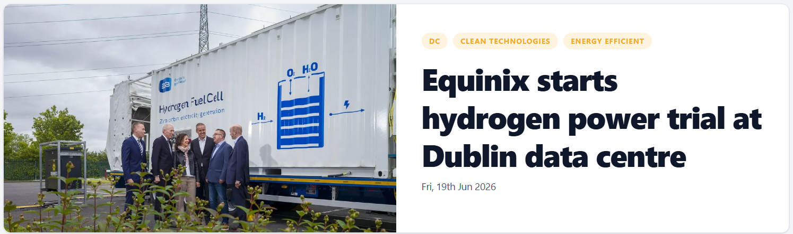
IRISH MEDIA RECOGNISED THE OPPORTUNITY
BusinessPlus.ie
Irish Independent
RTE
Data Centre News

Slide 33

AGNES WARNER
Agnes Warner
Property Director at Pure Data Centres Group, responsible for property strategy, utilities and operational leadership across an international hyperscale data centre portfolio.

Slide 34

Speaker Introduction
Agnes Warner MBA
Property Director, Pure Data Centres Group — responsible for property strategy, utilities and operational leadership across an international hyperscale data centre portfolio.
Focus 01
Focus 02
Focus 03
Property & Operations
Energy Innovation
Strategic Perspective
More than 15 years in the data centre sector, with leadership roles spanning property, operations, energy procurement, commercial strategy and organisational transformation.
Led the adoption of one of Europe’s first large-scale biomethane-backed energy solutions for data centres in Dublin — a practical, commercially viable route to cut emissions from critical infrastructure.
Work focused on the commercial, operational and strategic challenges of supporting the growth of digital infrastructure and the energy that enables it.
Experience Spans
Credentials & Platform
Energy procurement — customer requirements and long-term supply strategy
Operational resilience — reliability and continuity across a hyperscale portfolio
Market growth & sustainability — the expanding role of energy in enabling digital infrastructure
Executive MBA graduate and Lean Six Sigma practitioner
Regular speaker and panellist on energy transition, biomethane and hydrogen
Contributor on energy security and the future of sustainable digital infrastructure
Beyond the Grid: Clean Hydrogen Pathways for Data Centres — Section 4: Policy, Economics & Market Signals
Policy, Economics & Market Signals for Hydrogen Adoption
01 / 11

Slide 35
Section 4 — Policy, Economics & Market Signals
Policy Frameworks Driving Hydrogen Adoption
A maturing regulatory landscape — from national hydrogen strategies to EU-level mandates — is creating binding demand signals that unlock investment confidence.
Layer 1
Layer 2
Layer 3
EU Mandate
National Strategy
Project-Level Certainty
REDIII, Hydrogen & Decarbonised Gas Markets Package, and Delegated Acts set binding blending targets, renewable hydrogen quotas, and certification rules — reducing ambiguity for project developers.
Member state hydrogen strategies translate EU mandates into domestic production targets, subsidy frameworks, and infrastructure roadmaps — creating the national policy architecture for investment.
Clear certification rules and CBAM competitive pressure on imports reinforce domestic green hydrogen demand — giving project developers bankable offtake and investment certainty.
Key Regulatory Instruments
Investment Signals Created
REDIII — mandatory renewable hydrogen quotas for hard-to-abate sectors
Delegated Acts — additionality, temporal & geographical correlation rules for green certification
CBAM — competitive pressure on carbon-intensive imports reinforces domestic demand
Binding demand signals in hard-to-abate sectors provide offtake visibility for project finance
Certification clarity reduces contract risk and supports bankable green hydrogen agreements
Cross-border trade rules enable EU-scale hydrogen market formation
Key tension: Policy ambition outpaces infrastructure and offtake market development — the gap this section addresses directly.
Policy, Economics & Market Signals for Hydrogen Adoption
02 / 11

Slide 36
Indicative LCOH Trajectory
Levelised Cost of Hydrogen (USD/kg) — directional improvement toward cost convergence
Economics & Investment
The Economic Case & Cost Trajectories
Green hydrogen is moving from a premium product toward cost competitiveness — but the window for decisive policy and investment action is now.
Key Cost Levers
Electrolyser CAPEX — costs have fallen materially; learning rates remain strong
Renewable electricity input — declining prices drive LCOH improvement
Capacity factor & financing cost — key variables at the project level
Policy support mechanisms — CfDs, H2 Global auctions, production tax credits bridge remaining gap
Investor signal: cost trajectory is credible — execution and policy stability are the remaining risk variables.
Green H₂ (high renewable resource)
Green H₂ (average market)
Cost parity zone
Policy bridge required — near-term economics depend on support mechanisms in markets where cost gap persists

Slide 37
Market Signals — Data Centres & Industrial Demand
Hyperscale data centre growth is emerging as a credible, large-scale demand anchor for hydrogen, alongside traditional industrial offtakers.
Primary Volume Signal
Additionality Layer
Industrial Demand
Data Centre Demand
Established — Near-Term
Emerging — High Growth
Steel
Ammonia
Refining
Chemicals
Hyperscale
Backup Power
Net-Zero
Grid Services
Primary near-term volume demand for clean hydrogen across hard-to-abate sectors
Power-intensive loads with corporate net-zero commitments create structured hydrogen demand as a flexible, dispatchable carrier
Offtake structures more mature; sector-specific decarbonisation mandates drive demand signals
vs
Hydrogen Europe identifies data centres as a material future offtaker — especially where grid decarbonisation lags corporate timelines
Foundational anchor for project economics and bankability in hydrogen project pipelines
CERRE highlights co-location and grid services as value-stacking opportunities; hyperscale operators moving beyond pilot to strategic planning
Sources: Hydrogen Europe Market Monitoring; CERRE Grid Integration Recommendations
04 / 11

Slide 38
Section 4 — Policy, Economics & Market Signals
Ireland’s Starting Point — Obligation, Not Yet Revenue
CRU’s Large Energy Users connection policy and Ireland’s 2023 National Hydrogen Strategy set the conditions for hydrogen at data centres — but neither creates a hydrogen revenue stream.
Requirement
Framework
Caveat
CRU LEU Obligations
National Hydrogen Strategy
The Efficiency Caveat
New data centres must provide on-site or proximate dispatchable generation and/or storage matching maximum import capacity, participate in the electricity market, and source at least 80% of annual demand from additional renewable electricity generated in Ireland, subject to a glide path.
Ireland’s 2023 strategy directs renewable hydrogen to hard-to-electrify uses, long-duration storage and dispatchable power, while direct electrification remains preferable where practical.
Power-to-hydrogen-to-power carries material conversion losses; hydrogen’s advantage lies in storage duration and sector coupling, not round-trip efficiency.
What the Rules Require
What the Rules Do Not Do
Dispatchable capacity — on-site or proximate generation/storage matched to maximum import capacity
80% additionality — annual demand met with additional Irish renewable electricity, on a glide path
Market participation — obligation to participate in the electricity market, with a 1 MVA de-minimis threshold
No hydrogen-specific revenue floor — dispatchability is required, but hydrogen earns nothing automatically
No substitute for additionality — hydrogen does not discharge the separate renewable-electricity requirement
No guaranteed connection — system operators retain discretion to refuse in constrained regions such as Dublin
Key point: policy creates a role for clean dispatchable assets — the commercial case must still be built from support, market value and avoided fossil cost.
Policy, Economics & Market Signals for Hydrogen Adoption
05 / 11

Slide 39
Grid Integration
Key Policy Considerations
LEU Connection Policy:
Enabler or Bottleneck?
CRU Direction: Conditional Connection
CRU's LEU policy signals a shift toward flexible connection agreements — accelerating grid access timelines while requiring hydrogen operators to define and price curtailment risk upfront.
Large Energy User connection policy is a decisive enabler — or bottleneck — for hydrogen projects seeking grid access at scale.
Coordinated Planning (CERRE Recommendation)
CERRE advocates for coordinated planning between hydrogen demand centres — including data centres — and grid operators, to avoid piecemeal connection outcomes that undermine project economics.
Grid Connection
Queue management, connection agreements, and access conditions governed by CRU LEU policy direction.
Value Stacking: Co-location & Grid Services
Co-location of hydrogen production with demand centres creates grid services opportunities — curtailment response, demand flexibility — that can improve project revenue stacks.
Flexible Agreement
Conditional connections accelerate timelines but require operators to manage curtailment exposure.
Policy Ask
Electrolyser Operation
Clear, bankable connection frameworks with defined curtailment rules and long-duration contracts — removing project finance uncertainty and enabling investment decisions at scale.
Connection terms directly shape electrolyser load factors — a core driver of hydrogen output volumes.
LCOH Impact
Load factor variability feeds directly into Levelised Cost — making connection policy a financial issue, not just regulatory.
Policy, Economics & Market Signals for Hydrogen Adoption
06 / 11

Slide 40
Carbon Pricing — Raising the Fossil Counterfactual
Carbon pricing improves hydrogen’s relative position against diesel and gas, but coverage must not be overstated — legal incidence differs by installation.
EU ETS applies to covered stationary installations under Directive 2003/87/EC; inclusion depends on permitted activities and rated thermal input. Irish carbon tax applies via excise duties on fossil fuels outside the ETS, with reliefs to avoid double carbon pricing.
EU ETS
Coverage Varies
Irish Carbon Tax
€100/tCO₂ by 2030
Policy Direction
Avoid Exemptions
Applies to covered stationary installations. Standby status alone does not determine inclusion — site-specific permitting and legal review are essential.
For non-ETS diesel or gas backup, the tax raises fuel cost but is unlikely alone to close the renewable-hydrogen premium. Effect strengthens over asset life.
Ireland should avoid a data-centre-specific carbon exemption, maintaining predictable fossil-carbon escalation without overlapping ETS and tax liabilities.
Three Counterfactuals Operators Should Model
1
Diesel Backup
2
Natural-Gas Generation
3
Hydrogen / Fuel-Cell Resilience
Generator capital and maintenance, fuel, carbon exposure, emissions permitting and replacement risk
Lower point-of-use carbon than diesel, with allowance or tax exposure over asset life
Modelled on lifecycle emissions — point-of-use zero does not mean zero lifecycle emissions under EU rules
Policy, Economics & Market Signals for Hydrogen Adoption
07 / 11

Slide 41
Renewable-Hydrogen Subsidies — Reducing Price and Offtake Risk
Two external mechanisms address the two risks that matter most to a new Irish supply chain: uncertain price and uncertain early offtake. Ireland should adapt both, not copy them wholesale.
Price-Gap Support
Bankability Layer
EU Hydrogen Bank
UK HPBM / LCHA
Auction-Based — Proven
Contractual — Stronger Template
Auctions
€/kg Premium
10 Years
EU Fund
Strike Price
Reference Price
Volume Risk
Long-Term
Competitive auctions under the Innovation Fund award a fixed premium per kilogram of verified renewable hydrogen for up to ten years.
The Low Carbon Hydrogen Agreement provides long-term contractual revenue support through a strike-price and reference-price structure.
Competition reveals the minimum support requested, closing part of the gap between production cost and the price buyers will pay.
vs
It includes mechanisms addressing qualifying volume risk — the stronger template for producer bankability.
Verdict — ADAPT: Irish projects may be too small or fragmented to compete alone; DECC and SEAI should aggregate demand and create a top-up or demonstration window.
Verdict — ADAPT: a competitive Irish Renewable Hydrogen Agreement could offer a time-limited premium and limited volume protection, conditional on certified supply, additional renewable electricity and firm offtake.
Contracts should normally sit with the hydrogen producer or cluster — not subsidise individual fuel-cell assets indefinitely.
08 / 11

Slide 42
Electricity-Market Reform
Key Policy Considerations
Pay for the Service,
Not Merely the Molecule
Obligation Is Not Revenue
CRU policy creates a duty to participate in the market, not a guarantee of revenue — participation is subject to technical qualification, availability and market rules.
Hydrogen-to-power is credible only when measured against the complete fossil-resilience alternative — not against wholesale electricity alone.
Publish a Qualification Pathway
CRU, EirGrid and SONI should set out a technology-neutral route showing how hydrogen fuel cells or engines qualify as dispatchable generation, capacity and system-service providers — including testing, metering, minimum run-time and fuel-security evidence.
Avoided Diesel
Displacing diesel backup removes fuel, emissions permitting and replacement-risk costs from the counterfactual.
Enable Private Wire & Co-location
Irish rules should let additional or constrained renewable generation supply electrolysers and shared storage where efficient and consistent with EU rules.
Connection Optionality
Dispatchable on-site capacity can ease connection constraints and defer network reinforcement.
Reward Duration, Not Throughput
Capacity & System Services
A demonstration auction should reward verified availability, duration and emissions performance rather than energy throughput — avoiding unnecessary hydrogen combustion while valuing resilience that batteries or grid reinforcement cannot provide at the required duration.
The Single Electricity Market can value energy, capacity and system services where assets qualify.
Curtailment & Resilience
Electrolysers can absorb constrained renewable output that would otherwise be lost, while longer-duration autonomy reduces exposure to extended grid outages.
Policy, Economics & Market Signals for Hydrogen Adoption
09 / 11

Slide 43
The Integrated Economic Test for Irish Data Centres
Hydrogen is commercially credible only where the combined value stack closes the gap against the best alternative — compared on total annualised cost and service quality, not fuel price alone.
The assessment must set the full hydrogen system against the full fossil counterfactual, then add the system value the asset is demonstrably qualified to earn and any transparent, competitively awarded subsidy net of grants — with no double recovery and a defined route to declining support.
Fossil Counterfactual
Baseline
Hydrogen System
Full Cost
System Value
Upside
Generator capital and maintenance, diesel or gas, legally applicable EU ETS or carbon-tax exposure, emissions permitting, testing, fuel security and expected replacement risk.
Fuel-cell or hydrogen-ready generator capital, certified hydrogen delivered cost, storage and safety infrastructure, efficiency losses, maintenance and contracted fuel availability.
Capacity and system-service revenue the asset is qualified to earn, avoided connection or network costs, curtailed-renewable capture, and the value of longer-duration resilience.
Where the Test Lands
1
Strongest — Backup & Long-Duration Resilience
2
Possible — Flexible Peaking
3
Weakest — Continuous Prime Power
Annual hydrogen consumption stays low while the value of dependable capacity is high.
Viable where market revenue and renewable fuel supply are contractable.
Electrolysis and reconversion losses mean direct renewable electricity is normally more efficient, and high utilisation magnifies fuel-price exposure.
Policy, Economics & Market Signals for Hydrogen Adoption
10 / 11

Slide 44
ACER & Hydrogen Europe Market Monitoring — What the Data Says
Independent market monitoring confirms momentum but flags execution gaps that require coordinated action from regulators, operators, and investors.
ACER provides the regulatory baseline — tracking project pipelines, offtake contracts, infrastructure utilisation, and cross-border flows. Hydrogen Europe complements with industry-side data: electrolyser deployment rates, financing close rates, and demand-side contract activity.
Project Pipeline Growth
Strong
Offtake Contract Formation
Lags Pipeline
Financing Gaps
Persist
Pipeline of announced and permitted hydrogen projects is expanding across EU member states. ACER monitoring confirms healthy project formation rates.
Offtake contract formation consistently lags the project pipeline. Without committed offtakers, projects stall before reaching final investment decision.
Financing gaps persist where policy certainty is lowest. Early offtake commitments from large consumers — including data centres — convert pipeline into operating capacity.
Prioritised Ireland Action Plan
1
Irish Renewable Hydrogen Agreement (2027–2029)
2
Data-Centre-Linked Hydrogen Valley
3
Hydrogen-to-Power Market Pathway
DECC, with SEAI and Finance, to competitively award a declining, time-limited price premium with narrowly defined volume protection to certified producers or multi-user clusters.
One competitively selected, location-led demonstrator combining data-centre resilience demand with other users, shared electrolysis, storage and logistics.
CRU, EirGrid and SONI to publish how certified hydrogen assets meet LEU obligations and qualify for energy, capacity and system services — clarity, not preferential dispatch.
Policy, Economics & Market Signals for Hydrogen Adoption — Section 4
11 / 11

Slide 45

PAUL MCCORMACK
Paul McCormack,
CEO of Hydrogen Ireland

Slide 46
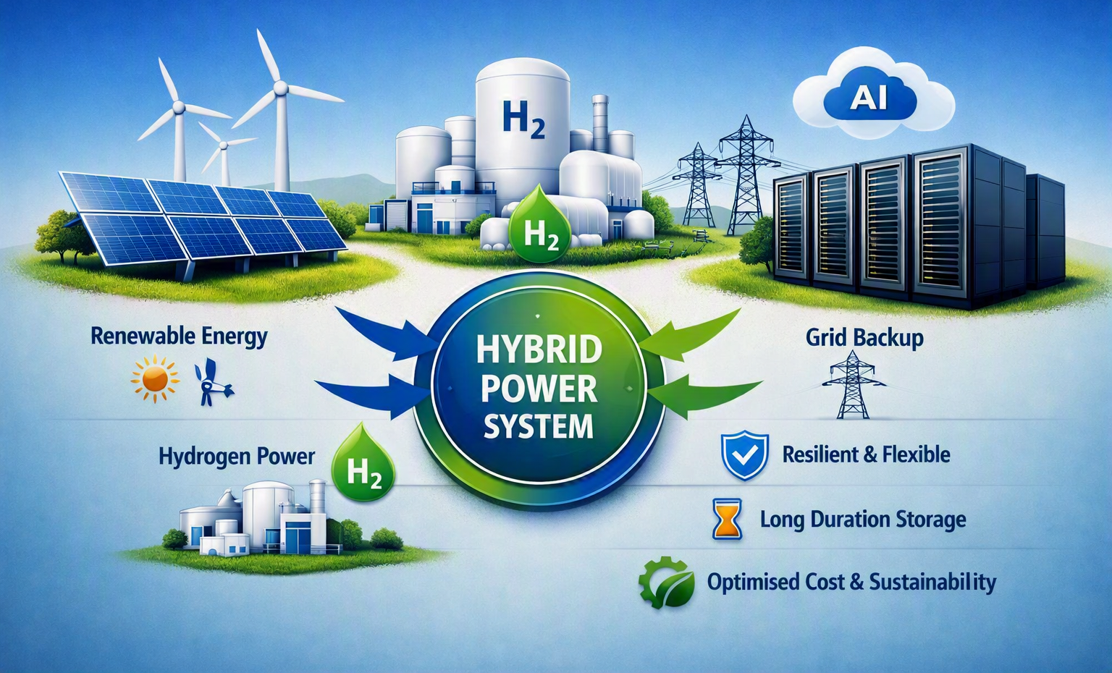
HYBRID MODELS & GLOBAL HYDROGEN LESSONS
Hybrid Energy Models
Data centres are shifting to hybrid systems combining renewables, hydrogen, and limited grid reliance.
This blended model delivers resilience, flexibility, and long‑duration stability for AI‑driven workloads.
Hybrid operation reduces exposure to grid congestion and optimises cost and sustainability.

Slide 47
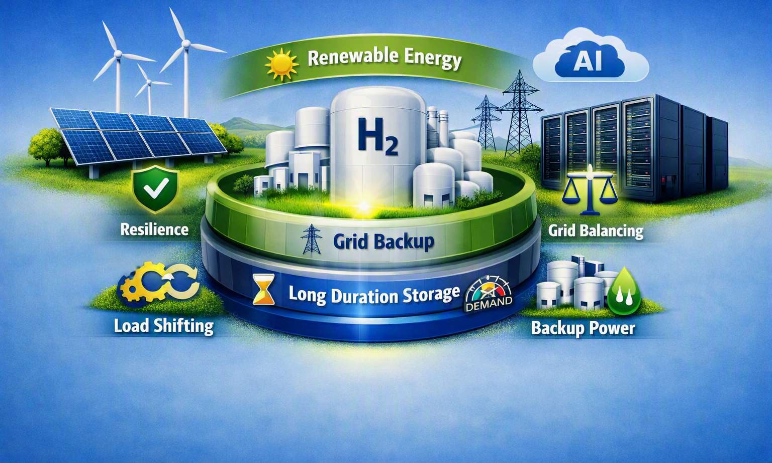
HYDROGEN AS THE FLEXIBILITY LAYER
Hydrogen provides firm, dispatchable power and long‑duration storage.
It stabilises renewable‑heavy systems and supports microgrid or near‑grid operation.
Hydrogen Europe’s 2025 briefing highlights hydrogen’s role in securing reliable energy amid grid constraints.

Slide 48
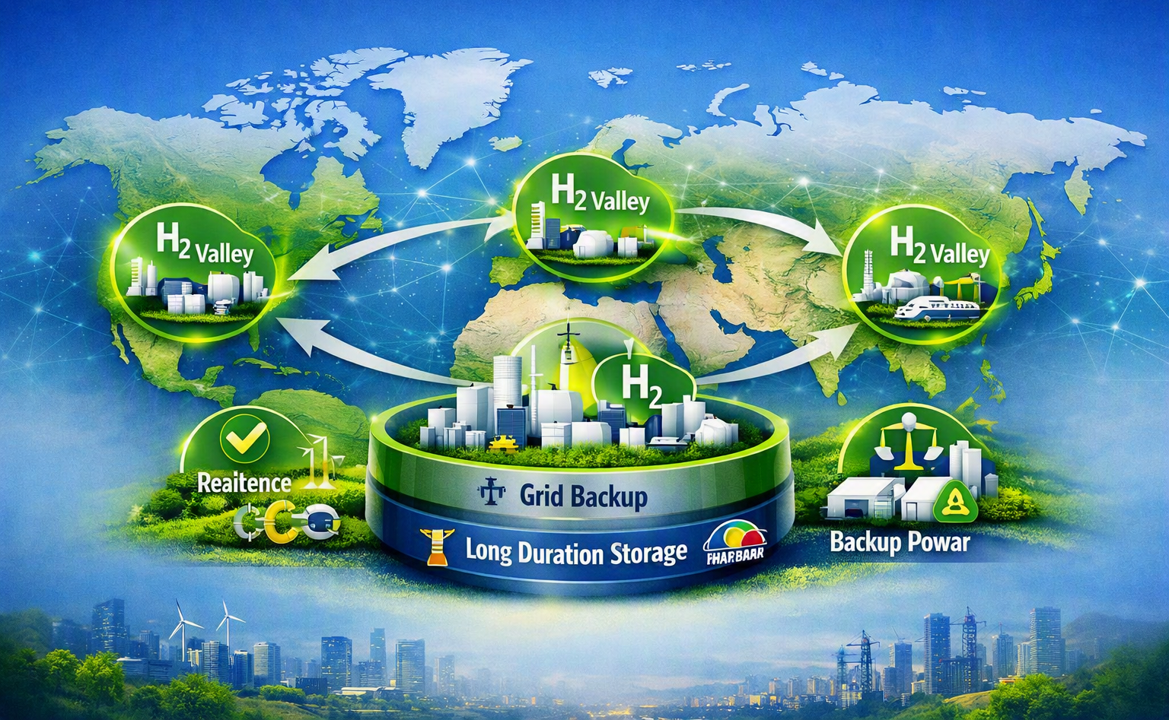
GLOBAL HYDROGEN VALLEYS
Europe, Asia, and North America are demonstrating scalable hydrogen ecosystems.
Netherlands, Germany, Austria, and Japan show how hydrogen valleys anchor industrial demand.
These models offer a blueprint for hydrogen‑enabled digital clusters.
Notes:
REINFORCE THE SHIFT IN MINDSET: DATA CENTRES SUPPORT SYSTEM STABILITY RATHER THAN THREATEN IT.

Slide 49

DATA CENTRES AS EARLY ADOPTERS
Microsoft’s hydrogen trials in Ireland and Wyoming prove feasibility and scalability.
Singapore’s hydrogen‑ready testbeds show adaptability in dense urban environments.
South Korea’s digital campus pilots integrate hydrogen with microgrids for high‑density clusters.
Notes:
REINFORCE THE SHIFT IN MINDSET: DATA CENTRES SUPPORT SYSTEM STABILITY RATHER THAN THREATEN IT.

Slide 50

STRATEGIC ADVANTAGES
Hybrid hydrogen‑renewable systems hedge risk and reduce exposure to volatile electricity markets.
They enable deep decarbonisation of backup systems and long‑duration storage.
They create new energy headroom where grid expansion is slow or constrained.

Slide 51

IRELAND’S LEADERSHIP OPPORTUNITY
Ireland can pioneer hydrogen‑enabled digital infrastructure and set the European benchmark.
Offshore wind and emerging hydrogen strategies position Ireland for first‑mover advantage.
Success here would allow Ireland to lead Europe toward secure, sustainable, interdependent digital‑energy ecosystems.

Slide 52
THREE KEY TAKEAWAYS FOR THE AUDIENCE
1. Clean Hydrogen Microgrids Offer a Viable Path to Data‑Centre Energy Autonomy
  Hydrogen‑powered microgrids can provide secure, dispatchable on‑site generation that reduces dependence on constrained grid capacity. For operators facing grid‑connection delays or curtailment risk, hydrogen offers a credible alternative route to expansion.
2. Hydrogen Enables Resilience, Flexibility, and Zero‑Carbon Backup Power
  Hydrogen systems can deliver long‑duration, emissions‑free backup power — overcoming the limitations of diesel and battery‑only solutions. This strengthens operational resilience, supports sustainability commitments, and aligns with emerging regulatory expectations for low‑carbon standby generation.
3. Early Adoption Creates Strategic Advantage in a Tightening Energy Landscape
  Data‑centre operators who integrate hydrogen early will be better positioned to secure energy capacity, meet ESG targets, and future‑proof operations against tightening emissions rules. Hydrogen is not a distant technology — it is deployable now, and early movers will shape the next phase of Europe’s digital‑energy infrastructure.

Slide 53
THANK YOU
Q & A
‘Hydrogen delivers the three pillars of a secure energy future, stability, sovereignty, and security, by enabling nations to produce, store, and dispatch their own clean power on demand.’
Hydrogen transforms energy independence into reality, stabilising grids, strengthening sovereignty, and safeguarding Europe’s energy and data systems for generations to come.’
Notes:
Mirroring Northern Ireland’s experience and is echoed across parts of Europe.

Slide 54

Notes:
REINFORCE THE SHIFT IN MINDSET: DATA CENTRES SUPPORT SYSTEM STABILITY RATHER THAN THREATEN IT.

