Slide 1
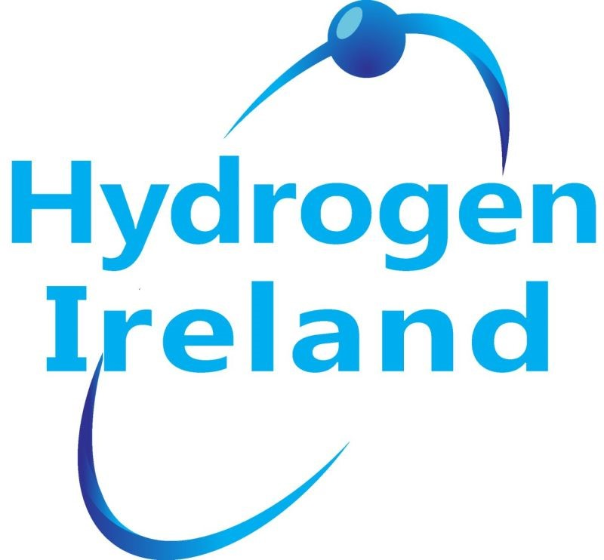
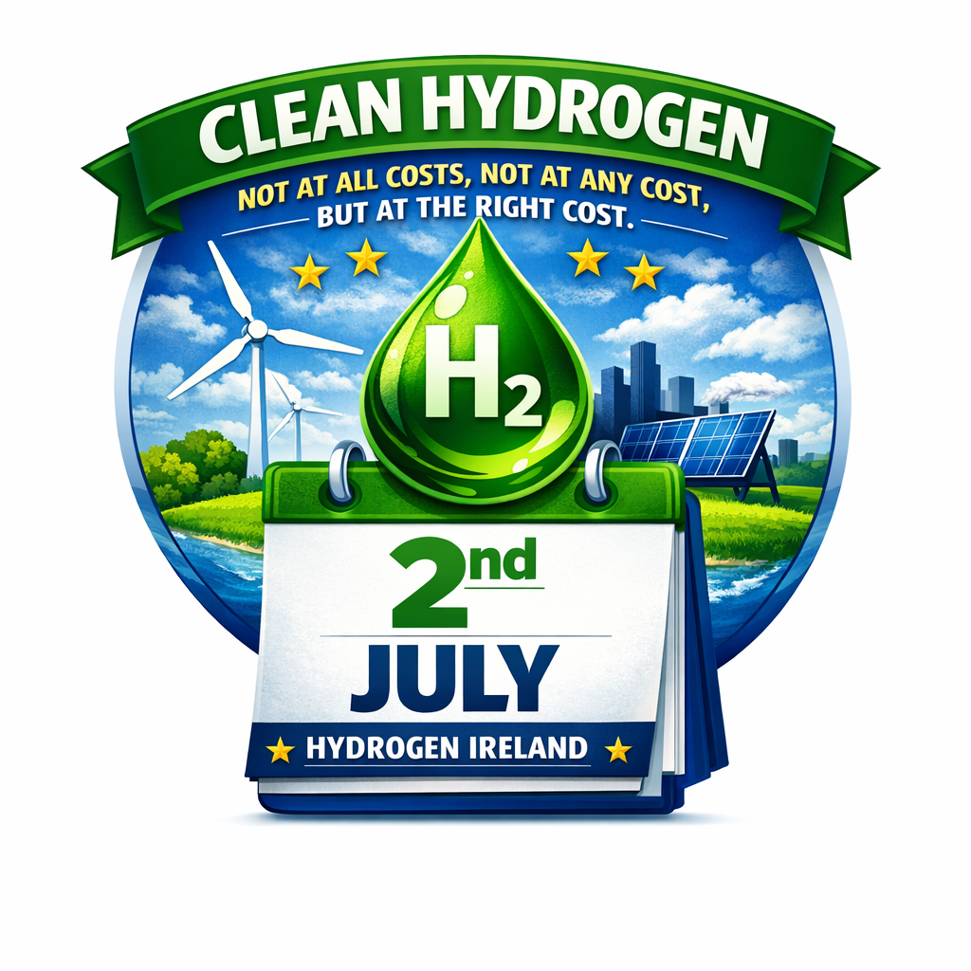
Hydrogen Ireland
Irish Presidency 2026
Webinar series
2nd July
Hydrogen not at all costs, not at any costs but at the right cost
Hosted by
Pinsent Masons

Slide 2
AGENDA
1. Welcome Address – Erin McGreehan, TD
2. Setting the Scene – Garrett Monaghan Pinsent Masons, Chair of Hydrogen Ireland
3. Technology Pathways and Innovation – Paul McCormack Hydrogen Ireland
4. Policy, Regulation, and Market Design – Hager Bassyouni Hezelburcht / First Blue
5. Societal and Environmental Impact – Alicia Eastman- Eastman Corporation
6. Global Partnerships and Strategic Investment -Carmen Font. Font Corporation
Notes:
Walk through the system visually: curtailed wind feeds electrolysis, hydrogen is stored, and power is supplied to the data centre when needed. This architecture reduces grid stress and improves resilience.

Slide 3

Welcome Address
Erin McGreehan, TD
Notes:
This enhanced diagram shows the full energy logic of a Green Data Valley
This is not a speculative hydrogen vision. This is a practical system architecture that starts with curtailed wind, begins with resilience and backup, and scales into deeper system integration as hydrogen markets mature.
Surplus wind feeds electrolysis via private wire.
Hydrogen is stored and later converted back to power through fuel cells to support data centre operations, with optional grid interaction for resilience and market optimisation.
Grid is repositioned correctly
The grid is now shown as:
supportive, not dominant
a source of resilience and arbitrage
a beneficiary of flexibility and balancing
This visually reinforces the shift from grid load → grid asset.

Slide 4
balance
The increasing focus on reducing greenhouse gas emissions and transitioning to a low-carbon economy has led to a growing interest in clean hydrogen as a clean energy carrier.
However, the production of green hydrogen, which is derived from renewable energy sources, comes with a significant cost premium compared to traditional hydrogen production methods.
As the demand for clean hydrogen grows, it is essential to strike a balance between the need for a low-carbon energy source and the economic viability of its production and its use cases.

Slide 5
ambition
I believe we need to champion a Europe that sees hydrogen not as a future aspiration but as a present economic opportunity.
I also believe Ireland should set itself an ambitious goal—to become Europe's first zero-curtailment economy.
Not because curtailment will ever disappear completely. But because every possible unit of renewable electricity should have somewhere productive to go. Into hydrogen. Into storage. Into sustainable fuels. Into advanced manufacturing. Into exports.
That should be our ambition.

Slide 6
Go raibh mile maith agaibh
Ireland has the renewable resources. We have the research excellence. We have the talent. We have political ambition. Now we must match that ambition with pace and its this pace that I’m the most frustrated about.
Because the race is no longer about who believes in hydrogen.
The race is about who delivers first and I want Ireland to win that race.
Go raibh mile maith agaibh - Thank you.

Slide 7

Setting the Scene
Garrett Monaghan
Pinsent Masons
Chair of Hydrogen Ireland
Notes:
Reinforce the shift in mindset: data centres support system stability rather than threaten it.

Slide 8
Price
In 1892, Oscar Wilde wrote that “a man who knows the price of everything and the value of nothing” is the very definition of a cynic. More than a century later, that observation feels uncomfortably relevant to today’s energy crisis. We live in an age where price is instantly visible, endlessly compared, and politically amplified, yet true cost remains largely hidden.

Slide 9
Defining the “Right Cost” for Clean Hydrogen
The ‘right cost’ is not the lowest number on a tender sheet. It is the point where ambition and affordability meet, where hydrogen delivers:
System value — flexibility, storage, grid stability, and renewable integration
Societal value — jobs, skills, regional regeneration, and community resilience
Environmental value — deep decarbonisation where no other vector works
Geopolitical value — reduced exposure to volatile fossil markets
Industrial value — competitiveness, innovation, and long‑term capability
Clean hydrogen must be measured not only in euros and dollars, but in the avoided costs of inaction, the resilience it creates, and the strategic autonomy it unlocks.

Slide 10
From Price to Value - Rewriting the Energy Equation
The “right cost” is not the lowest cost. It is the cost that delivers the highest value — economically, environmentally, and geopolitically.
This is the foundation for a credible hydrogen strategy. This is how we separate real potential from promotional distractions. This is how we ensure hydrogen is deployed where it matters most. And this is how we build an energy system that is resilient, affordable, and future‑proof.

Slide 11
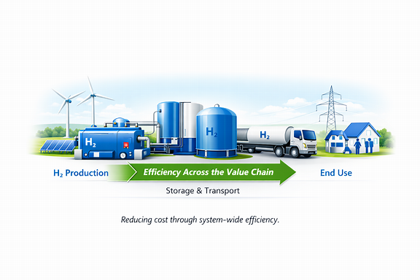
Technology Pathways and Innovation
Paul McCormack
Hydrogen Ireland

Slide 12
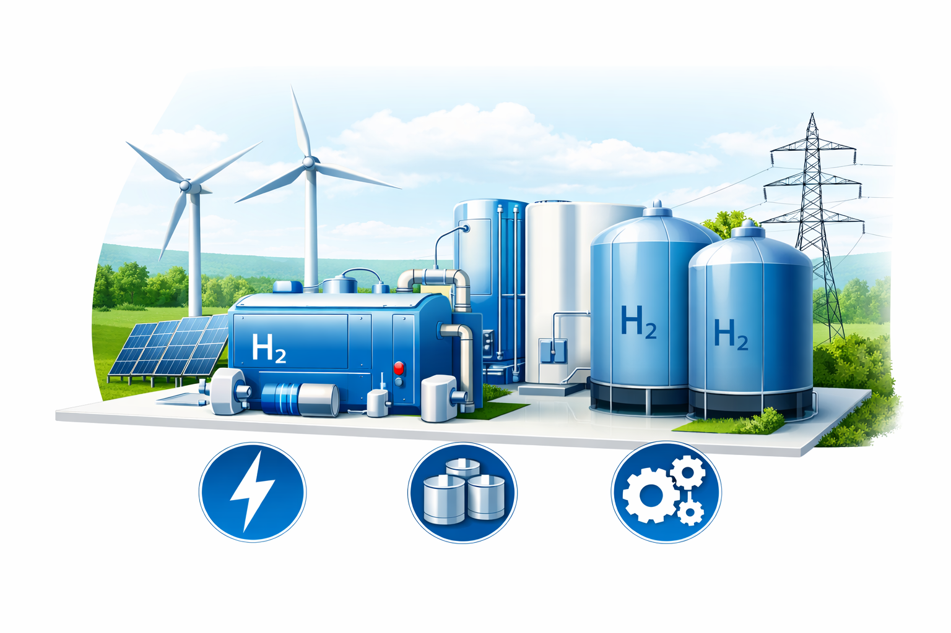
Efficiency First: Scaling Clean Hydrogen Without Waste
Clean hydrogen must scale without unnecessary cost or system inefficiency.
“Innovation is the key to making hydrogen cost effective without compromising quality or impact.”
Focus areas: electrolysers, storage, and system integration.

Slide 13
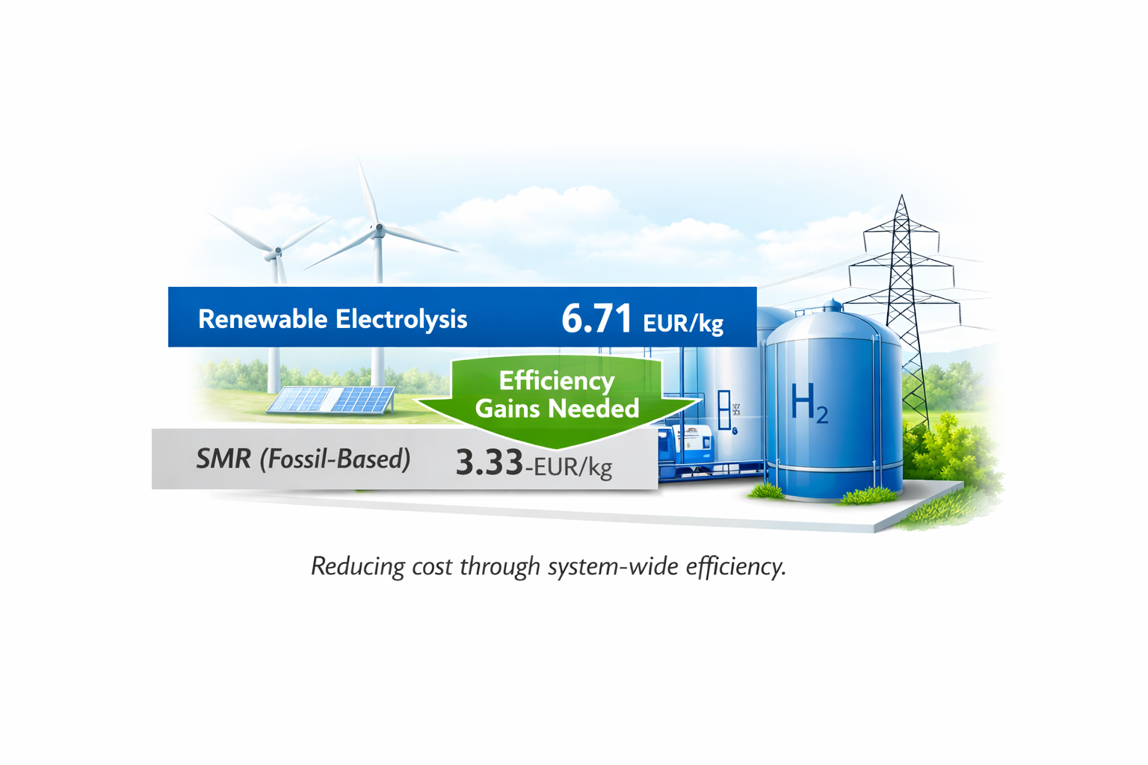
The Cost Challenge
Renewable‑based electrolysis remains significantly more expensive than fossil‑based hydrogen.
Europe 2024 LCOH (renewables): 6.71 EUR/kg (range 4.3–10.5).
SMR average cost: 3.33 EUR/kg.
Efficiency improvements must target the entire value chain.

Slide 14
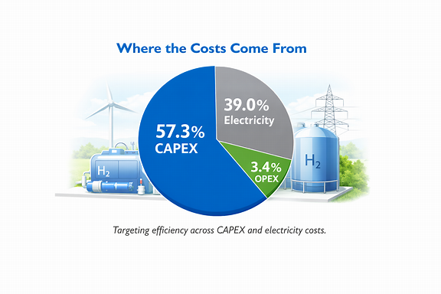
Where the Costs Come From
LCOH cost breakdown (2024):
57.3% CAPEX (3.85 EUR/kg)
39.0% electricity (2.62 EUR/kg)
3.4% OPEX (0.23 EUR/kg)
CAPEX drivers: stack, balance of plant, utilities, buildings, storage.
Electricity cost driven by renewable intermittency and electrolyser capacity factor.

Slide 15

Electrolyser Technology Landscape
Four main pathways: Alkaline, PEM, AEM, SOEC.
TRLs (2025):
Alkaline & PEM: TRL 9
SOEC: TRL 8
AEM: TRL 7
Despite maturity, LCOH remains high → innovation essential.

Slide 16
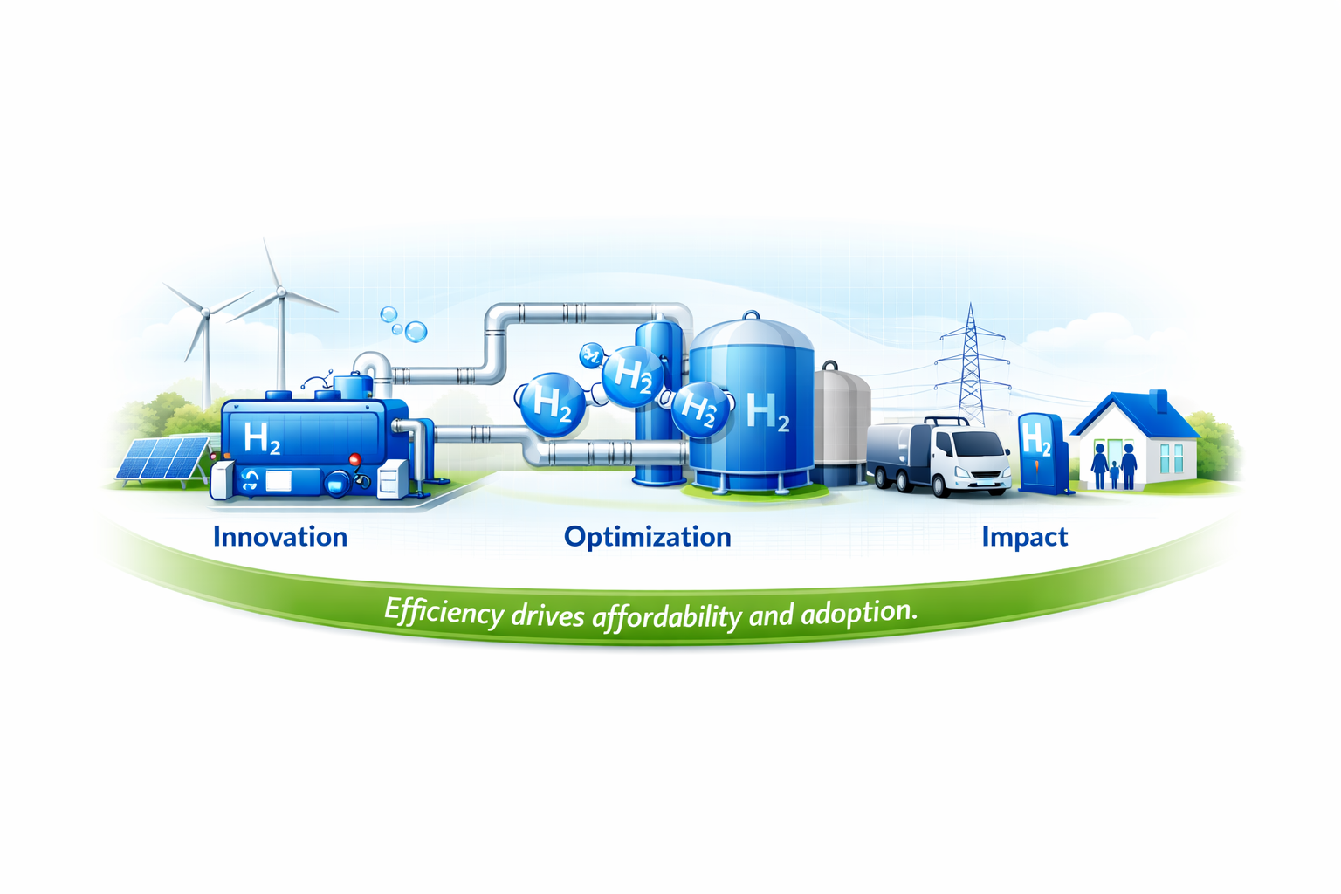
Strategies to Reduce Electrolyser Costs
Improve electrical efficiency → lower kWh/kg H₂.
Reduce precious metal loading (iridium, platinum).
Enhance durability under dynamic operation.
Scale manufacturing + advanced production methods.
AI‑driven materials discovery accelerating optimisation.

Slide 17
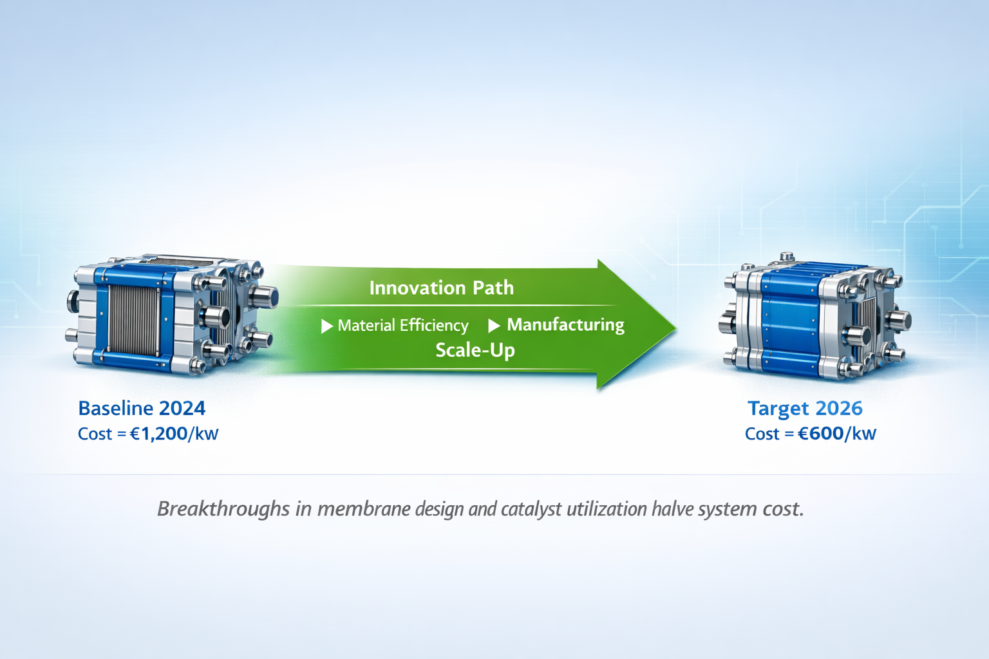
Breakthrough Example: PEM Cost Reduction
NREL 2024 analysis: 50% reduction in total PEM system cost possible.
Largest gains from:
Lower anode catalyst loading
Higher current densities
1 MW system cost reduction: 891 → 374 $/kW (−58%).
Stack cost reduction: 316 → 31 $/kW (−90%).

Slide 18
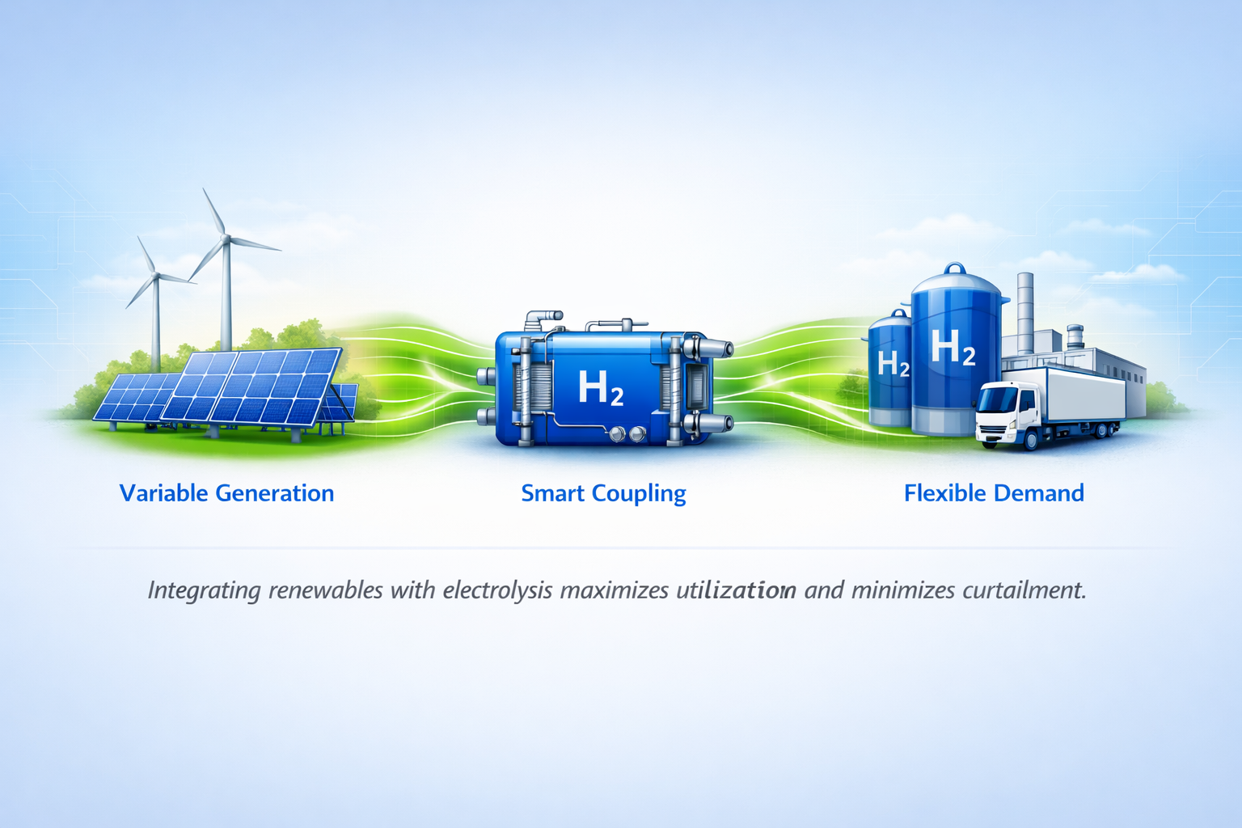
Renewables–Electrolyser Coupling
Intermittency stresses electrolysers and reduces lifetime.
Integration strategy is as important as stack design.
“Coupling strategies, operating regimes, and achievable capacity factor all affect system efficiency.”
Whole‑system optimisation required.

Slide 19
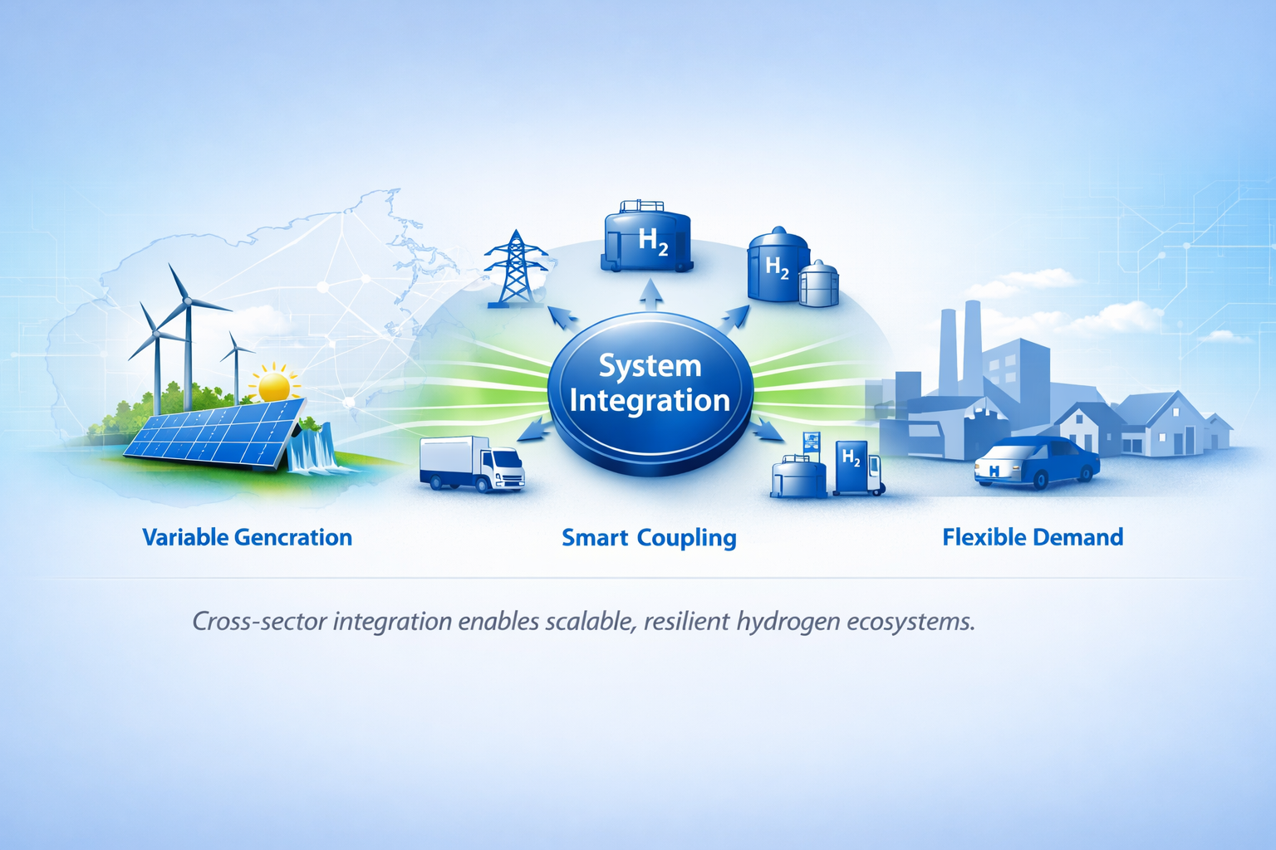
Case Studies in System Integration
ERM Dolphyn (UK)
Floating offshore wind + offshore electrolysis.
Avoids HV cable losses; hydrogen piped to shore.
Demonstrates variable load performance and offshore conditions.
ATMOSPHERE (Spain)
100 MW PV + 5 MW battery + 20 MW PEM.
Battery smooths intermittency → higher output & longer stack life.

Slide 20
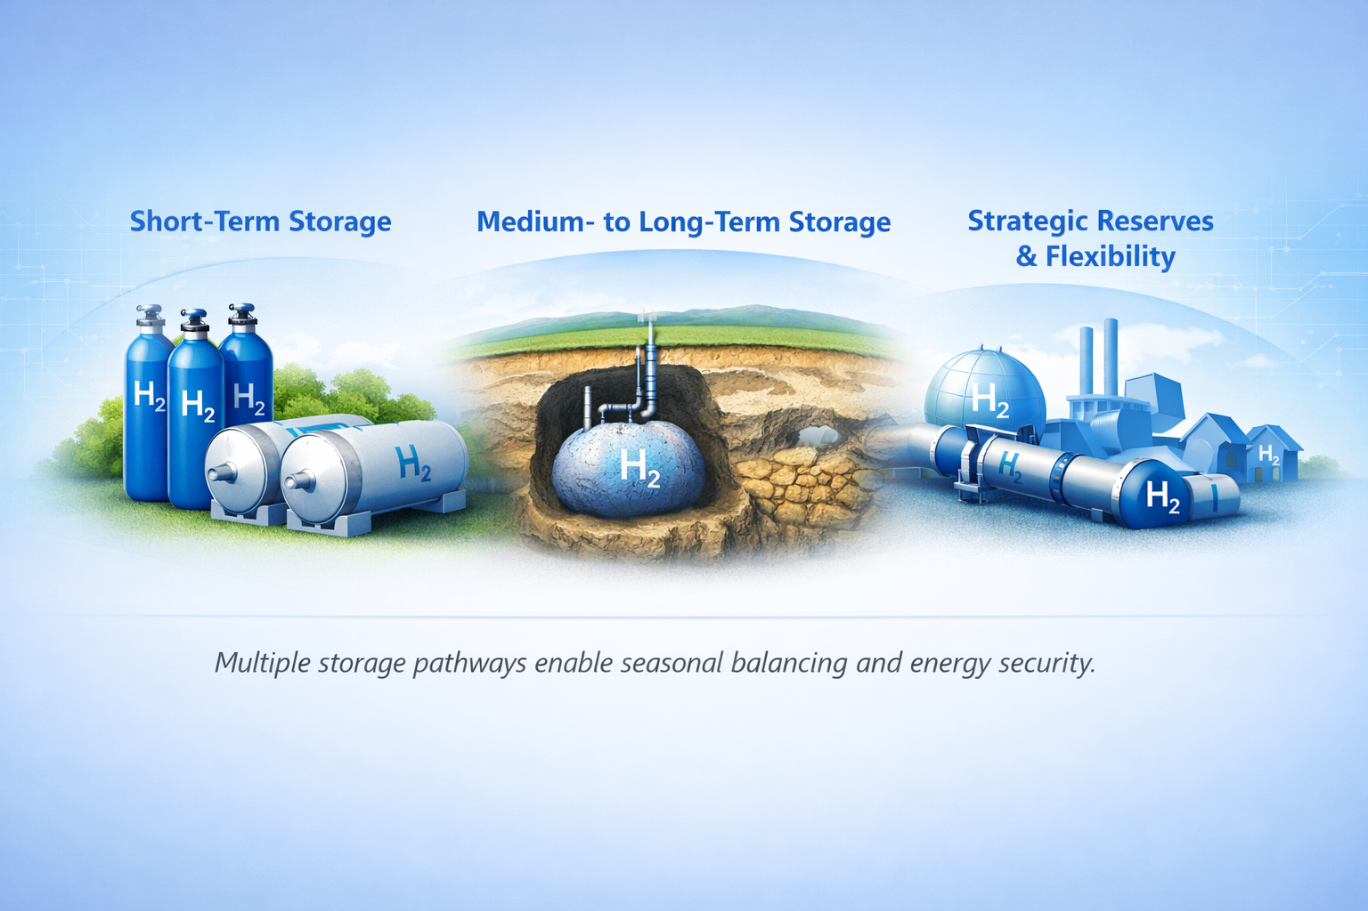
Hydrogen Storage Pathways
Materials‑based: metal hydrides (TRL 5), adsorbents (TRL 3).
Above‑ground physical: ammonia, LH₂, pressure vessels (all TRL 9).
Underground: salt caverns (TRL 9), depleted gas fields (TRL 5), aquifers (TRL 3).
Storage is essential for balancing variable production and demand.

Slide 21
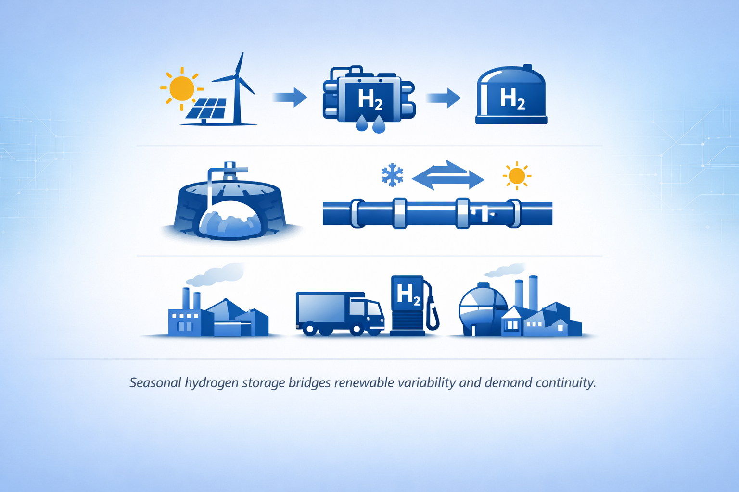
Seasonal Storage Breakthrough
Underground Sun Storage 2030 (Austria)
Uses underground sandstone reservoir + solar‑powered PEM electrolysis.
Stores 4.2 GWh summer surplus for winter power & heat.
World‑first (2023) with two successful seasonal cycles completed.
Demonstrates hydrogen as a long‑duration renewable buffer.

Slide 22
Summary: Efficiency First in Clean Hydrogen
Clean hydrogen remains cost‑constrained, with renewable electrolysis still ~2× the cost of SMR.
Efficiency gains must target the whole system: electrolyser design, renewable coupling, and storage.
Electrolyser innovation—materials optimisation, reduced precious metal loading, higher current densities, and advanced manufacturing—can cut system costs by up to 50–60%.
Smart integration with renewables (offshore wind, PV + battery hybrids) improves capacity factors and extends asset life.
Storage breakthroughs, especially underground seasonal storage, enable hydrogen to act as a long‑duration energy buffer for renewables.
The pathway to affordable clean hydrogen is clear: efficiency first, waste eliminated, system‑wide optimisation.

Slide 23

Policy, Regulation, and Market
Hager Bassyouni
Hezelburcht / First Blue
Notes:
Reference H2Irl - Green Data Valleys paper framing. AI, cloud computing, and high‑performance digital services are driving demand.
2026 marks a turning point where data centres emerge as a credible offtake class for clean hydrogen, initially through backup, resilience, and hybrid systems.

Slide 24
Technology Alone Is Not Enough
Market Barriers to Deployment
High capital costs for electrolysers and infrastructure
Uncertain and fragmented demand signals
Cost competitiveness gap vs fossil fuels
Underdeveloped transport and storage networks
Lack of long-term offtake agreements
What Policy Must Deliver
Correct for underpriced environmental damage
De-risk early investment through targeted incentives
Create predictable long-term demand via regulation
Build the cross-border infrastructure backbone
Certification and trust to enable traded markets
Notes:
The technology story is compelling -- electrolyser costs are falling, system integration is improving. But falling costs do not automatically translate into deployment.
Markets do not invest in new energy systems on the promise of future economics alone. We need policy to bridge the gap: to correct market failures, build investor confidence, and create the demand signals that make projects bankable.
There is a structural mismatch between production costs and what buyers are willing to pay. Green hydrogen levelised cost of production (LCOH) in most of Europe sits between roughly €4–7/kg unsubsidised, against grey hydrogen at €1.5–2.5/kg and blue hydrogen at €2–3.5/kg. The widely cited €2/kg competitiveness threshold for green hydrogen is achievable today only where electricity costs are below ~€20/MWh and electrolyser utilisation exceeds 5,500 hours/year — conditions met in only a handful of locations (Iberia, Norway, parts of the Nordics). Industry analysts (Buckle Bridge, April 2026) describe this as a "design, cost and commercial structure problem" rather than bad luck or policy noise.
Keep this framing in mind, because the rest of the talk is essentially a report card on how well that bridging has actually worked in 2025 and 2026.

Slide 25
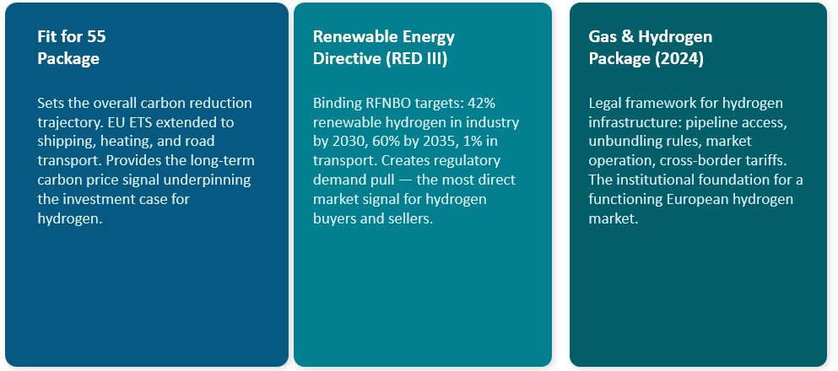
The EU's Hydrogen Policy Architecture
Notes:
The EU has constructed three interlocking policy pillars.
Fit for 55 sets the carbon price trajectory and emissions ambition that create the long-term case for clean energy investment.
RED III is the key demand-side instrument — it creates binding obligations on industrial and transport users to use renewable hydrogen. I will come back to the specific figures in a moment.
Note: verify the 60%/2035 figure against the final adopted RED III text before citing in formal documents.
The Gas and Hydrogen Decarbonisation Package, adopted in 2024, establishes the legal plumbing — pipeline access rules, unbundling, cross-border tariffs — that a traded hydrogen market requires.
Together these are not aspirations. They are binding legal obligations on member states.

Slide 26
The Reality Check: 2025-26 in Numbers
20%+
of EU hydrogen pipeline (29.2 GW) cancelled or stalled
~60
major clean hydrogen projects cancelled globally in 2025 (4.9 Mt/yr potential)
3.6%
of EU pre-2030 supply projects had reached FID as of 2024
Why projects are failing
High costs and economics: 32% of cancelled projects, 40% of lost capacity
Failure to secure funding: 18% of projects, 29% of lost capacity
Lack of demand: 11% of projects, 9% of lost capacity
Even winning a grant is no longer a safety net: 7 of 15 projects selected in the EU Hydrogen Bank's second auction later withdrew
Notes:
I want to be direct about where the market actually stands. Over a fifth of the European hydrogen pipeline -- 29.2 GW -- has been cancelled or stalled.
Globally in 2025, close to 60 major clean hydrogen projects were cancelled, representing almost 5 million tonnes a year of potential production -- against only about 1 million tonnes a year that actually reached FID or began construction that same year.
And this is the line I'd underline for this audience: winning a grant is no longer a safety net. Seven of the fifteen projects selected in the EU Hydrogen Bank's second auction later withdrew, after having already won funding. That is a new and important signal.

Slide 27
EU Hydrogen Bank: Promise vs Delivery
Auction | Period | Budget | Bids | Outcome
1st (IF23) | Nov 2023 - Feb 2024 | €720M | 132 | 7 projects selected; 1 later withdrew
2nd (IF24) | Dec 2024 - Feb 2025 | €1.2bn | 61 | 15 selected (2.34 GW); 7 withdrew after winning (1.88 GW)
3rd | Dec 2025 - Feb 2026 | €1.3bn | 58 | 9 projects selected (6x oversubscribed); grant agreements expected Q4 2026
Roughly half of Auction 2's winners ultimately could not proceed. Only 6 of the eventual signees (Spain, Finland, Norway) had completed grant agreements by January 2026, totalling €270.6M. The Commission is expected to tighten EHB criteria further in 2026 to avoid a repeat.
Notes:
The Hydrogen Bank's first auction produced genuinely encouraging results -- winning bids of 37 to 48 cents per kilogram were lower than many expected.
But look at what happened in the second auction: fifteen projects were selected, representing 2.34 gigawatts of capacity. Seven of those, representing 1.88 gigawatts, later withdrew. Only six ultimately signed grant agreements, for a combined 270.6 million euros -- a fraction of the original ambition.
The Commission is responding by tightening criteria again for 2026, specifically to avoid a repeat. This is the auction mechanism working as a price-discovery tool, but it is also revealing that price discovery and bankability are not the same thing.

Slide 28
Funding: Commitment vs Disbursement
21%
of 122 IPCEI hydrogen projects have reached FID; only €12.8bn of €18.9bn pledged has been allocated
Hydrogen Europe analysis
€3bn
actually disbursed of €21.4bn in committed EU and member state funding
RMI, Feb 2026
35-70%
national subsidy intensity caps vary widely: Austria 35%, France 70%, Belgium/Flanders 50%
Strategic Energy Europe, 2025
3 countries
Germany, the Netherlands and France account for the large majority of funding deployed
RMI, Feb 2026
Notes:
This is where I'd ask the audience to update their mental model of EU hydrogen funding. The headline numbers are large -- 18.9 billion euros pledged through IPCEI -- but the lived reality is very different.
Only 21 percent of the 122 IPCEI hydrogen projects have reached Final Investment Decision. And of the 21.4 billion euros in committed EU and member state funding, only about 3 billion has actually been disbursed to projects and end users.
National subsidy rules also vary enormously -- Austria caps support at 35 percent of costs, France allows up to 70 percent. And funding remains heavily concentrated in just three countries: Germany, the Netherlands and France.
The point I want to land here: the binding constraint on European hydrogen scale-up may currently be administrative and disbursement capacity, not headline funding availability.

Slide 29
The China Challenge
50-86%
of global electrolyser manufacturing capacity is Chinese, depending on methodology
IEA / World Bank Group, Feb 2026
85-86%
Chinese share of global alkaline (ALK) electrolyser manufacturing specifically
World Bank Group, Feb 2026
39-40 GW
Chinese annual manufacturing capacity vs roughly 10 GW global demand in 2025-26
Green Building Africa, Feb 2026
45-60%
genuine cost gap on closer scrutiny - not the often-cited "75% cheaper"
CRU Group, Nov 2025
"Europe and the US relinquished their leadership in clean hydrogen to China in 2025." - H2TECH, Jan 2026
Notes:
Now to the thread that wasn't in earlier versions of this talk, but that I think is the most consequential development of the last twelve months: China.
China's share of global electrolyser manufacturing capacity is somewhere between 50 and 86 percent depending on methodology -- but in alkaline electrolysers specifically, the figure is consistently around 85 to 86 percent. China's annual manufacturing capacity, 39 to 40 gigawatts, is roughly four times current global demand.
On cost: you'll often hear that Chinese electrolysers are 75 percent cheaper. I'd push back gently on that figure -- CRU Group's analysis shows that comparison is usually stack-only Chinese pricing against full-system Western pricing. The genuine like-for-like gap is closer to 45 to 60 percent. Still very large, but worth being precise about, because the 75 percent figure tends to get repeated uncritically.
The industry framing for 2025, from H2TECH, is blunt: Europe and the US ceded hydrogen deployment leadership to China last year.

Slide 30
The EU's Response: The 25% Rule
How It Works
Introduced for the 2nd EU Hydrogen Bank auction (Dec 2024) after manufacturer pressure on the Commission
Caps Chinese-sourced electrolyser stack capacity at 25% (MWe) of project capacity
Paired with cybersecurity, ISO safety and NZIA-aligned resilience criteria
Explicitly framed as avoiding a repeat of the solar sector outcome
Where It Falls Short
Scope is narrow: stack only, not full balance-of-plant
Risk of circumvention via Chinese-EU joint ventures and local assembly
Applies only to EHB-funded projects, not IPCEI or private capital
Mechanically raises project LCOH at the moment cost is the binding constraint
Notes:
This is the EU's direct policy response to the China question. For the second Hydrogen Bank auction, the Commission introduced a hard cap: no more than 25 percent of electrolyser stack capacity, by megawatt, can be sourced from China.
This followed direct lobbying -- European electrolyser manufacturers wrote jointly to the Commission President after the first auction's surprisingly low winning bids raised concern that competitiveness was being achieved partly through cheap Chinese components.
But I want to flag the real limitations here, because I think this is where the policy debate is heading in 2026. The rule only covers the stack -- not the balance of plant. It only applies to Hydrogen Bank-funded projects, not IPCEI or private capital. And multiple industry observers already expect Chinese manufacturers to set up joint ventures inside Europe specifically to route around it -- which is exactly what happened in solar a decade ago.
The EU's 25% cap on Chinese-sourced electrolyser stack capacity is not an isolated measure — in May 2026 the European Commission also moved to bar EIB/EIF-backed solar, wind and battery storage projects from using inverters or power conversion systems from 'high-risk' countries including China, signalling a broader strategic-autonomy trend that is likely to keep tightening sourcing conditions — and potentially costs — across clean-tech supply chains, hydrogen included.

Slide 31
Creating Demand: RED III Mandates
Industry: Renewable Hydrogen Share Target
RED III Mandates
Industry: 42% renewable hydrogen by 2030, rising to 60% by 2035
Transport: minimum 1% RFNBO share by 2030
Why This Matters
Solves the chicken-and-egg problem by creating guaranteed demand before the market matures
Key Tension
Industrial users face real cost premiums. Mandates must be matched by infrastructure, financial support and realistic timelines.
60%
42%
2030
2035
Notes:
Supply incentives get most of the attention, but demand is where the market is ultimately made or broken. RED III is the EU's main demand-side lever -- the 42 percent industrial target by 2030, rising to 60 percent by 2035, is legally binding, not aspirational.
But there's a real tension here. Industrial users like steel plants and refineries currently use grey hydrogen at a fraction of the cost of green hydrogen. Mandating a switch without adequate support risks competitiveness damage, particularly for industries exposed to global competition and cheap imports.
Before we leave RED III, it's worth pausing on how 'renewable hydrogen' actually gets defined — because this is where a lot of the developer frustration sits.
Three criteria, all set out in the RFNBO Delegated Act, Regulation 2023/1184:
Additionality — the renewable electricity used for electrolysis has to be new generation, not diverted from the existing grid. In practice, this usually means a direct PPA with a new-build renewable asset, or co-location.
Temporal correlation — production has to be matched to renewable generation within a defined time window. Right now that's monthly matching; it tightens to hourly matching from January 2030 — which is the part developers worry about most, since it's operationally much harder to satisfy.
Geographical correlation — the electrolyser and the renewable generation need to sit in the same or a directly connected bidding zone.
The critique: developers argue these rules — especially the move to hourly matching — add real cost and complexity at exactly the moment the sector can least absorb it. But I'd flag the counterpoint too: a Nature piece earlier this year cautioned against assuming the rules themselves are the primary cause of delay, rather than underlying project economics — some projects did proceed to construction under these same rules in 2025.
Looking ahead: the Commission has just opened a consultation, running through June 2026, on a post-2030 renewable energy framework — with a legislative proposal expected by the end of this year. That's the real vehicle where these delegated-act rules could be revisited, not a confirmed 'RED IV.' Worth watching, but nothing is settled yet

Slide 32
National Funding: A Patchwork
Country | Approach | Notable Detail
Germany | IPCEI flagship projects, H2Global and KfW concessional loans | ~80% of Hy2Infra FIDs are German; new Hydrogen Acceleration Act fast-tracks permitting
Netherlands | World's highest electrolyser subsidy per GW (€1.43bn committed) | June 2025 government collapse put €2.8bn in pending subsidies at risk
France | Contract-for-difference model, up to €4/kg for 15 years | National co-funding cap of 70%; roughly €9bn committed through 2030
Funding concentration in Germany, the Netherlands and France reflects administrative capacity as much as political ambition.
Notes:
I want to show you briefly how differently member states are actually approaching this, because the EU-level instruments only tell half the story.
Germany remains the most administratively effective -- about 80 percent of Hy2Infra projects that have reached FID are German, and the new Hydrogen Acceleration Act is fast-tracking permitting further.
The Netherlands has committed the highest electrolyser subsidy per gigawatt in the world, but a government collapse in June 2025 put 2.8 billion euros of pending subsidies directly at risk -- a good illustration of how domestic political instability can undercut EU-level policy continuity.
France runs a contract-for-difference model with a generous 70 percent national co-funding cap, but a smaller absolute commitment than Germany.

Slide 33
2026: Three Tensions to Watch
01 Cost Realism vs Climate Ambition
EU 2030 targets are now widely seen as unreachable. The real choice is whether to recalibrate targets or substantially scale and accelerate funding.
02 Strategic Autonomy vs Cost Competitiveness
The 25% China rule protects nascent European manufacturing but raises costs precisely when cost is the binding constraint, and its narrow scope invites circumvention.
03 Funding Architecture vs Disbursement Capacity
Only 21% of IPCEI projects have reached FID, and just €3bn of €21.4bn committed has been disbursed. The binding constraint may be administrative, not financial.
The question for 2026 isn't whether Europe believes in hydrogen - it's whether its institutions can move at the speed its targets assume.
Notes:
To close, three tensions I'd encourage this audience to watch through the rest of 2026.
First, cost realism versus climate ambition -- the 2030 targets are now widely seen as unreachable, and the real conversation needs to be about recalibration versus dramatically faster funding, not pretending the targets are still on track.
Second, strategic autonomy versus cost competitiveness -- the China sourcing rule is a reasonable instinct given the solar-sector precedent, but it's narrowly scoped and mechanically raises costs at the exact moment cost is the binding constraint.
Third, and I think most underappreciated -- funding architecture versus disbursement capacity. The data suggests Europe's hydrogen bottleneck may be more administrative than financial.

Slide 34

Societal and Environmental Impact
Alicia Eastman
Eastman Corporation
Notes:
Position the policy and system context.
Ireland mirrors wider European challenges: rapid data centre growth, ambitious climate targets, and grid constraints.

Slide 35

Societal & Environmental Impact: Communities at the Core
Clean hydrogen must be pursued not at all costs, but at the right cost — with people and ecosystems at the centre.
Hydrogen’s legitimacy depends on community benefit, environmental integrity, and fairness.
The transition must deliver value beyond kilowatts and carbon metrics.
Success requires hydrogen to strengthen communities, protect nature, and support a just transition.

Slide 36
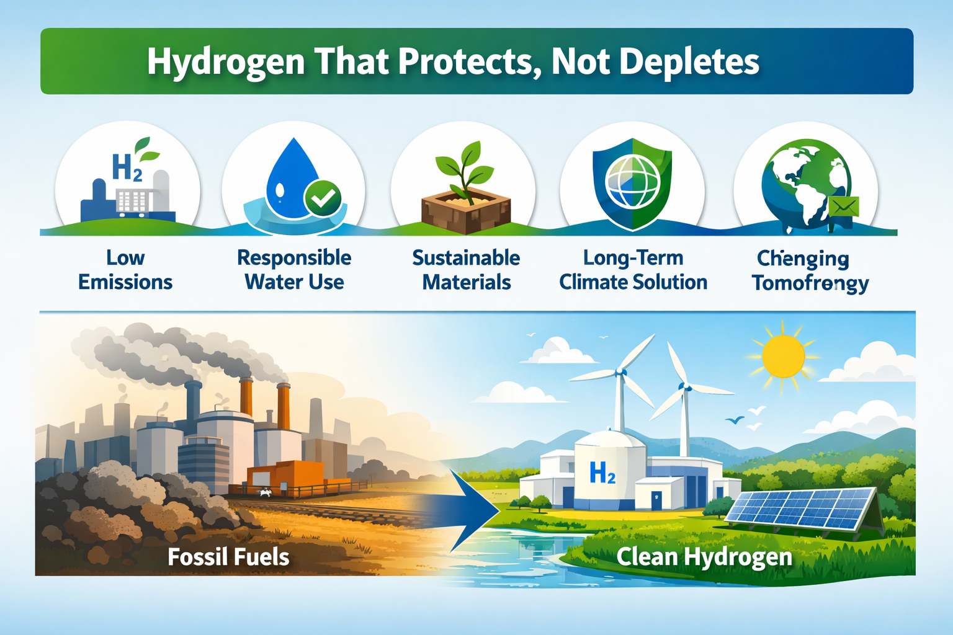
Why This Matters
Hydrogen as a Social & Environmental Project
Hydrogen cannot succeed as a purely technical or economic endeavour.
Public trust will determine the pace and scale of deployment.
Communities expect tangible benefits, not abstract promises.
Environmental performance is now a baseline requirement, not an optional add‑on.

Slide 37
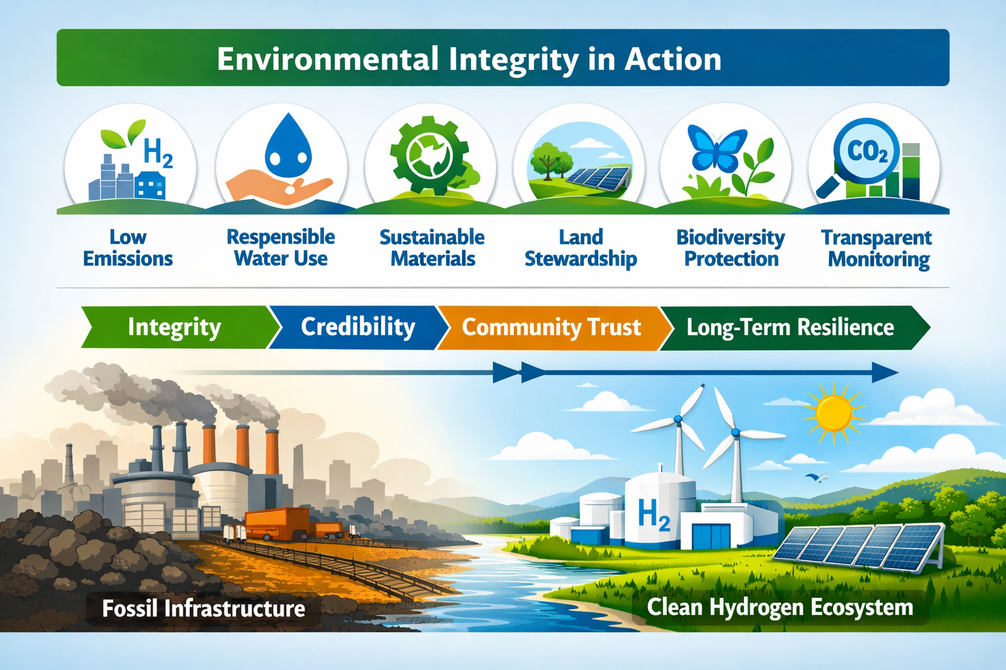
Environmental Integrity
Hydrogen That Protects, Not Depletes
Clean hydrogen must earn credibility through verified low or zero lifecycle emissions.
Renewable-powered electrolysis or accountable carbon capture are essential.
Environmental integrity is the denominator against which every project is judged.
Infrastructure must be designed around people and places, not the other way around.
Notes:
Fossil dependence perpetuates higher emissions and deeper instability.
Biodiversity loss accelerates as habitats collapse under climate stress.
Communities face rising adaptation costs and climate‑driven migration.
Clean hydrogen offers a pathway out, but only if deployed with integrity.
Delay transforms opportunity into crisis — time is the most expensive resource.

Slide 38
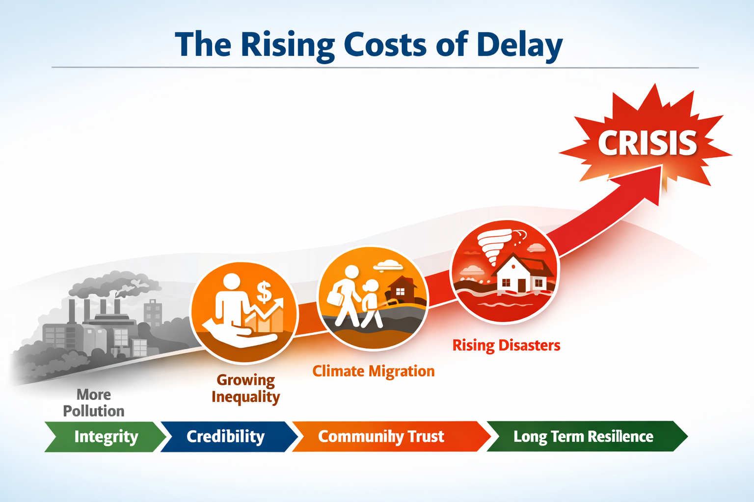
What Environmental Integrity Looks Like
Low/zero lifecycle emissions with transparent monitoring.
Responsible water use and careful land planning.
Sustainable sourcing of electrolyser materials.
Hydrogen positioned as a durable climate solution, not a temporary fig leaf for fossil expansion.
Notes:
that every year of delay compounds ecological damage and social cost, reinforcing the urgency for clean hydrogen deployment with integrity.
his slide visually reinforces that hydrogen adoption must be human‑centred, not just system‑driven — success depends on social legitimacy and shared benefit.

Slide 39
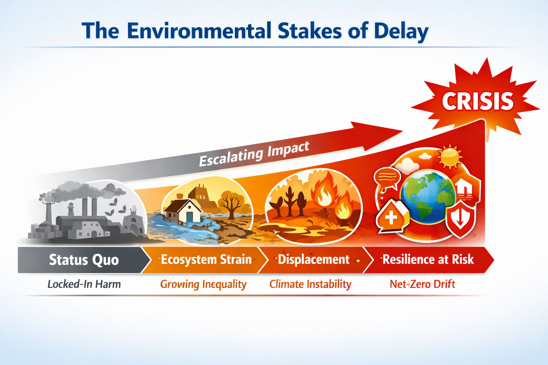
The Environmental Stakes of Delay
Continued fossil reliance deepens climate instability and biodiversity loss.
Every year of delay makes net-zero pathways harder and more expensive.
Communities face escalating climate impacts: flooding, heatwaves, ecosystem decline.
Clean hydrogen offers a pathway out — but only if deployed with integrity.

Slide 40
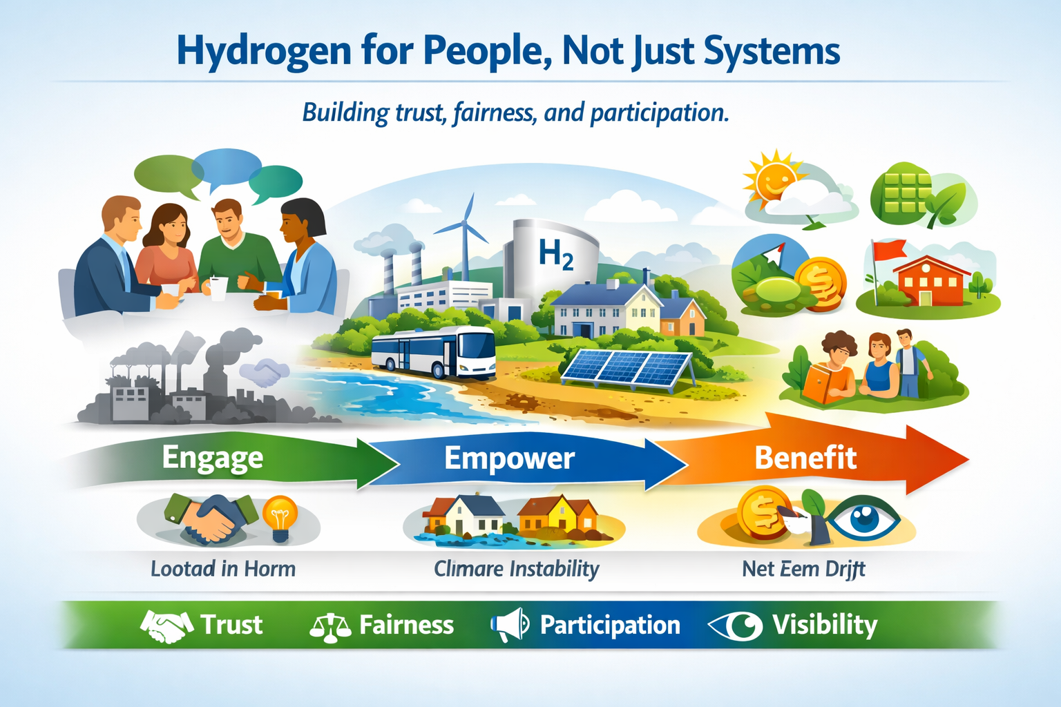
Social Acceptance
Hydrogen for People, Not Just Systems
Communities remember extractive industries that took value and left costs.
Hydrogen must deliver local jobs, skills, investment, and opportunity.
Community involvement must be meaningful, not symbolic.
A just transition for fossil-dependent regions is essential for legitimacy.
“Drill baby drill” symbolised the old model; hydrogen must represent the opposite.
Notes:
Hydrogen adoption depends on social legitimacy — communities must see tangible benefits, clear safeguards, and honest engagement. It’s not just about technology; it’s about people shaping the transition.

Slide 41
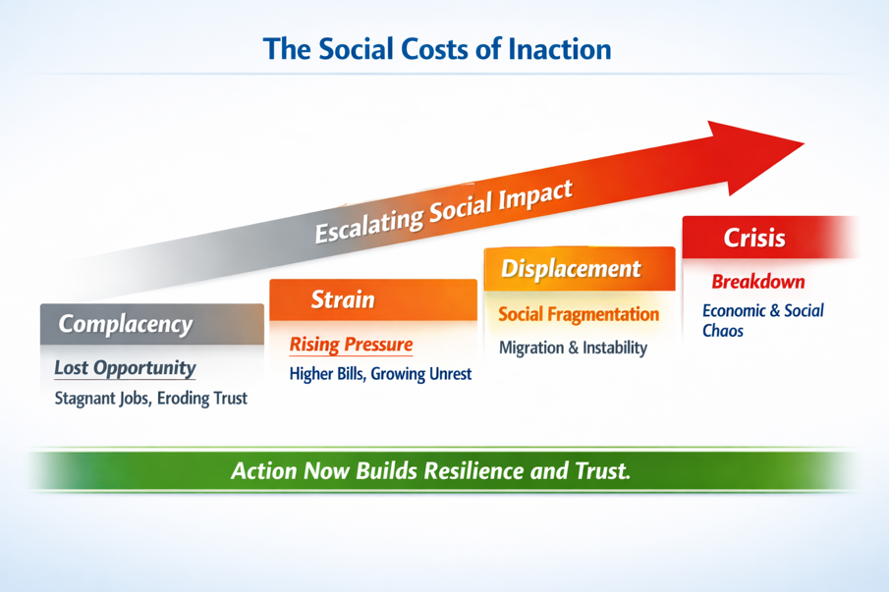
The Social Costs of Inaction
Pollution persists, disproportionately harming vulnerable communities.
Energy inequality widens under fossil-based systems.
Climate displacement accelerates, straining social and economic systems.
Fossil-dependent regions face unmanaged decline instead of planned renewal.
As Mark Welsh noted: hydrogen is “silver buckshot” — stabilising in a destabilising climate.
Notes:
Inaction multiplies inequality, dislocation, and distrust. Hydrogen leadership isn’t just technical — it’s social stewardship, ensuring communities thrive through the transition.

Slide 42

Safeguards That Build Public Trust
Transparent lifecycle emissions accounting.
Responsible water and land management.
Community benefit-sharing frameworks.
Skills pathways and local employment guarantees.
Biodiversity protection and environmental monitoring.
Governance that prevents greenwashing and speculative development.

Slide 43
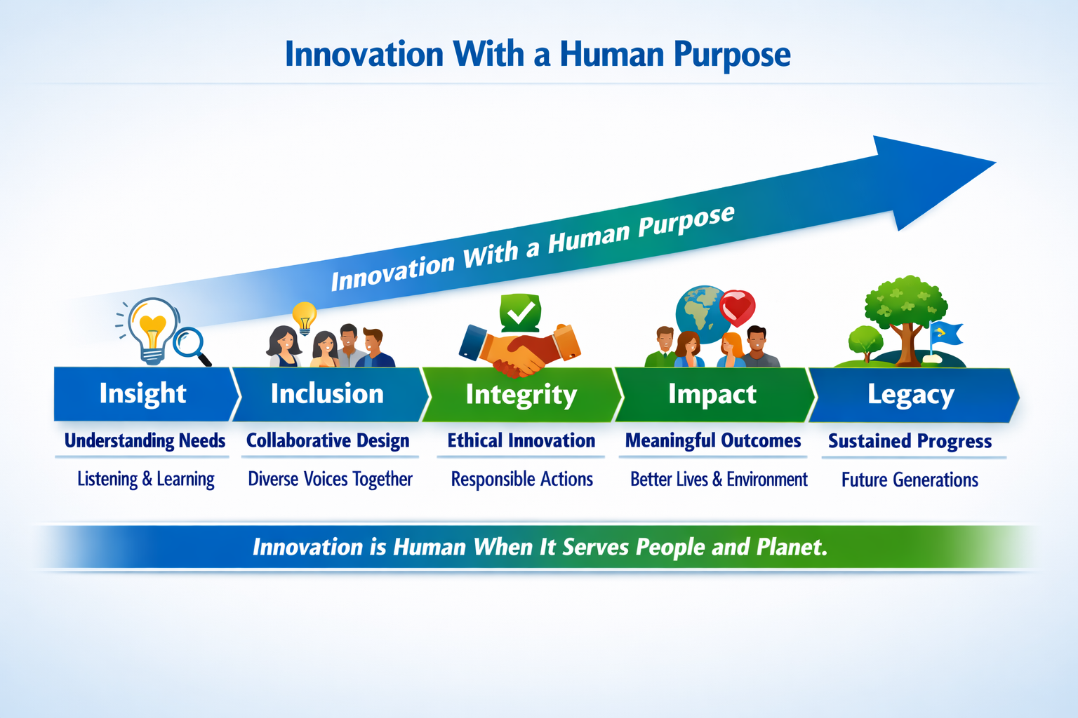
Innovation With a Human Purpose
Delayed investment risks losing industrial capacity and global competitiveness.
Clean hydrogen strengthens national resilience and energy sovereignty.
Innovation must serve society — not the other way around.
A diverse energy system reduces exposure to geopolitical shocks and volatile markets.

Slide 44
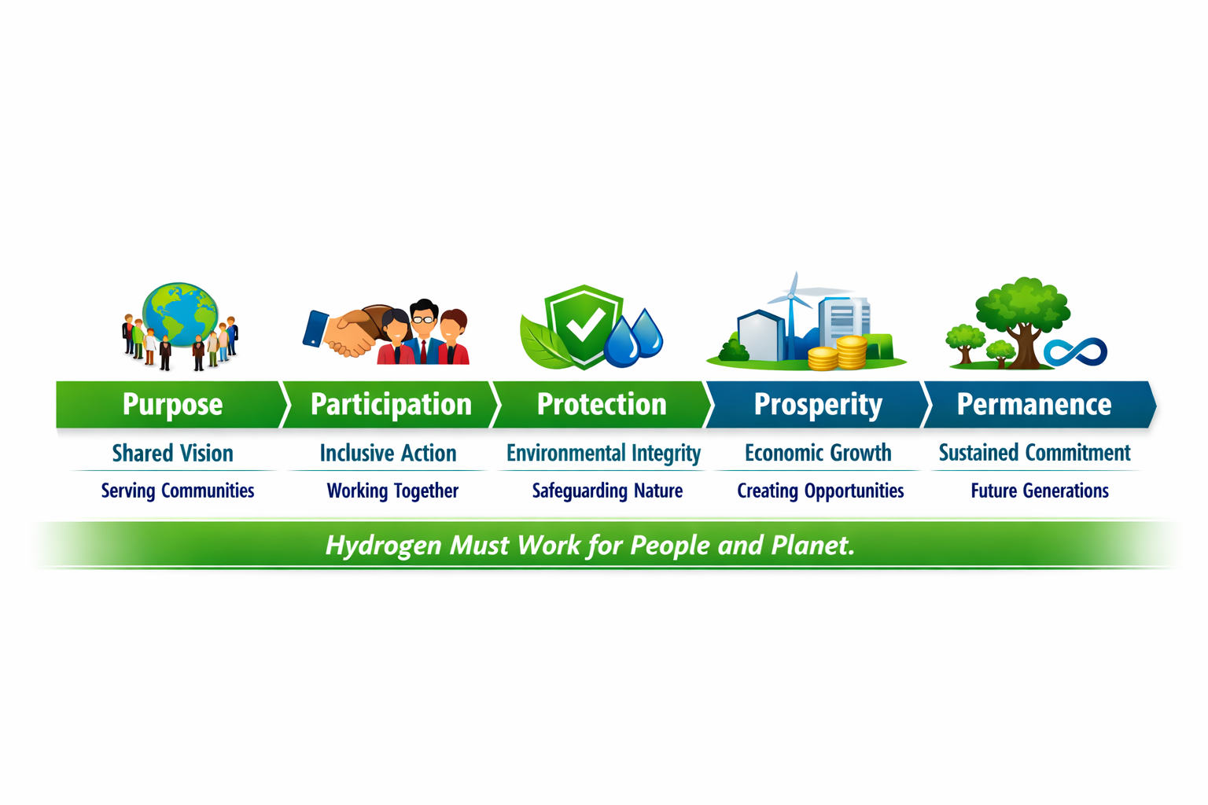
The Principle
Hydrogen Must Work for People & Planet
Hydrogen must clean the air, protect ecosystems, and create opportunity.
Done well, it becomes a catalyst for resilience, renewal, and shared prosperity.
Done poorly, it repeats the mistakes of the fossil era.
Hydrogen must earn its place environmentally, socially, and economically.
The right cost means communities and ecosystems at the centre of every decision

Slide 45

Global Partnerships and Strategic Investment
Carmen Font
Font Corporation
Notes:
While figures vary regionally, Ireland increasingly experiences surplus wind.
Mirroring Northern Ireland’s experience and is echoed across parts of Europe.

Slide 46



Clean hydrogen
Not at all cost, not at any cost but at the right cost
Dublin, 2 july 2026
Global Partnerships and Strategic Investments
FONT CORPORATION
Investments and Expansions in Europe
Notes:
Introduce the Green Data Valleys concept#
aligning digital infrastructure growth with renewable energy and hydrogen.
2. Emphasise relevance to Ireland and Europe.

Slide 47
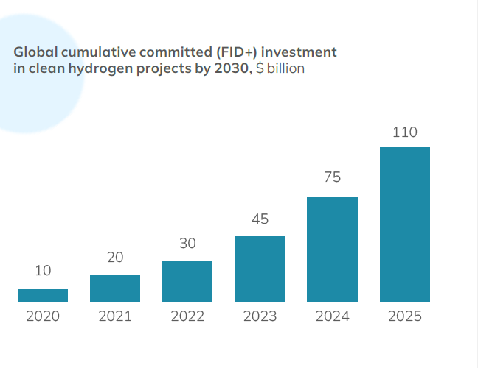
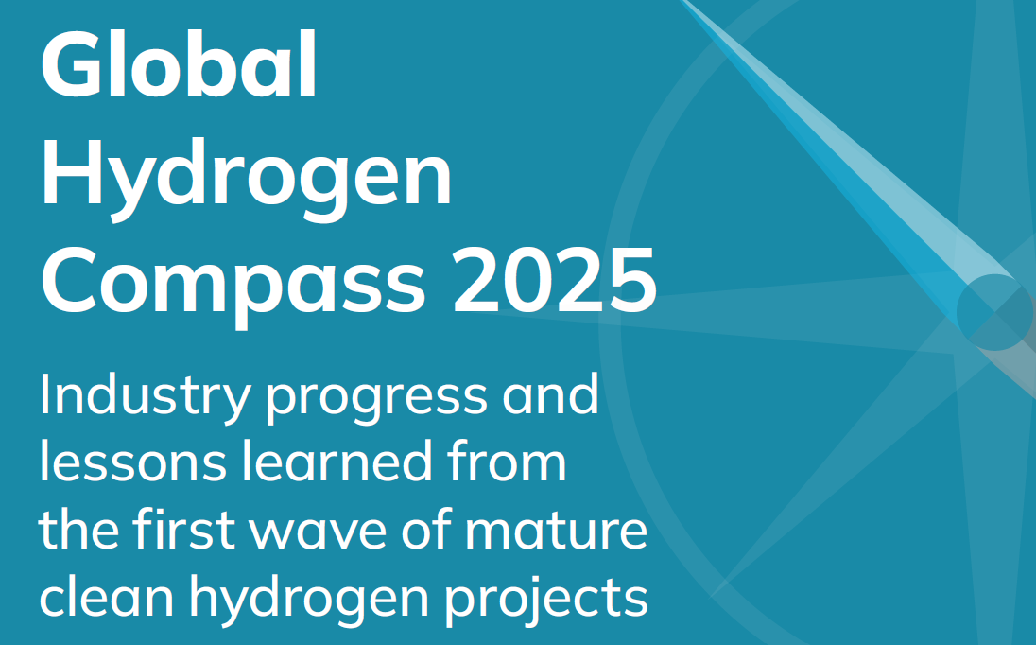
THE HYDROGEN COUNCIL
GLOBAL HYROGEN COMPASS 2025
1,700 projects were announced globally with a peak in 2022–2023
Maturation phase in 2025
    US $110 billion Investments Secured
    510 projects have taken FID globally
Notes:
Position the policy and system context.
Ireland mirrors wider European challenges: rapid data centre growth, ambitious climate targets, and grid constraints.

Slide 48
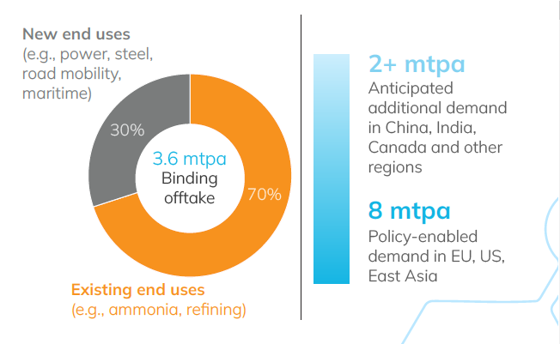
Where the market stands? OFFTAKE-CENTRIC
Roughly 3.6 mtpa of binding offtake has been secured globally.
Implementation and enforcement of existing policies could enable a total of up to 8 mtpa clean hydrogen demand by 2030 in key markets such as EU, US, Japan, and Korea
Further 13 mtpa could be unlocked through targeted infrastructure investment and continued cost reductions
#1 Certainty of offtake/demand, including captive
Source: Hydrogen Compass 2025
Notes:
While figures vary regionally, Ireland increasingly experiences surplus wind.
Mirroring Northern Ireland’s experience and is echoed across parts of Europe.

Slide 49

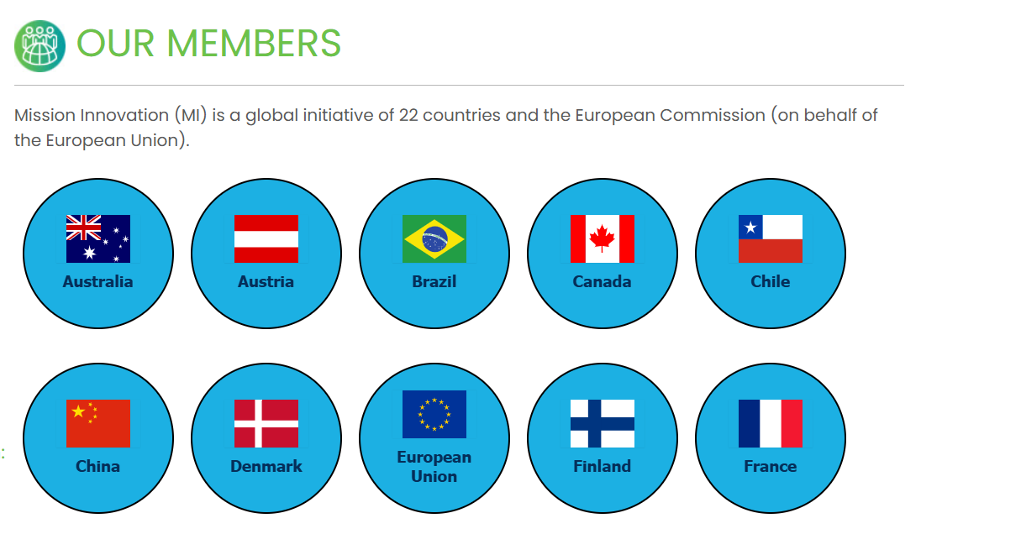
The Future of EUROPEAN COMPETITIVENESS
REINFORCING GLOBAL STRATEGIC ALLIANCES AND ATTRATIVENESS FOR INVESTORS
Mission Innovation is a global initiative catalysing a decade of action and investment in research, development and demonstration to make clean energy affordable, attractive and accessible for all. Members: 23 countries
MISSON INNOVATION 2030
Increase impact in Europe through:
1.1. Intensifying Non-European MEMBERSHIPS
1.2. Attracting INVESTMENTS (FDI) to the EU
1.3. Showcasing Euroepan Portfolio of Hydrogen Projects and Hydrogen Valleys
Source: Mission Innovation, European Commission
Notes:
Hydrogen integration starts modestly but creates the foundation for deeper coupling over time.

Slide 50
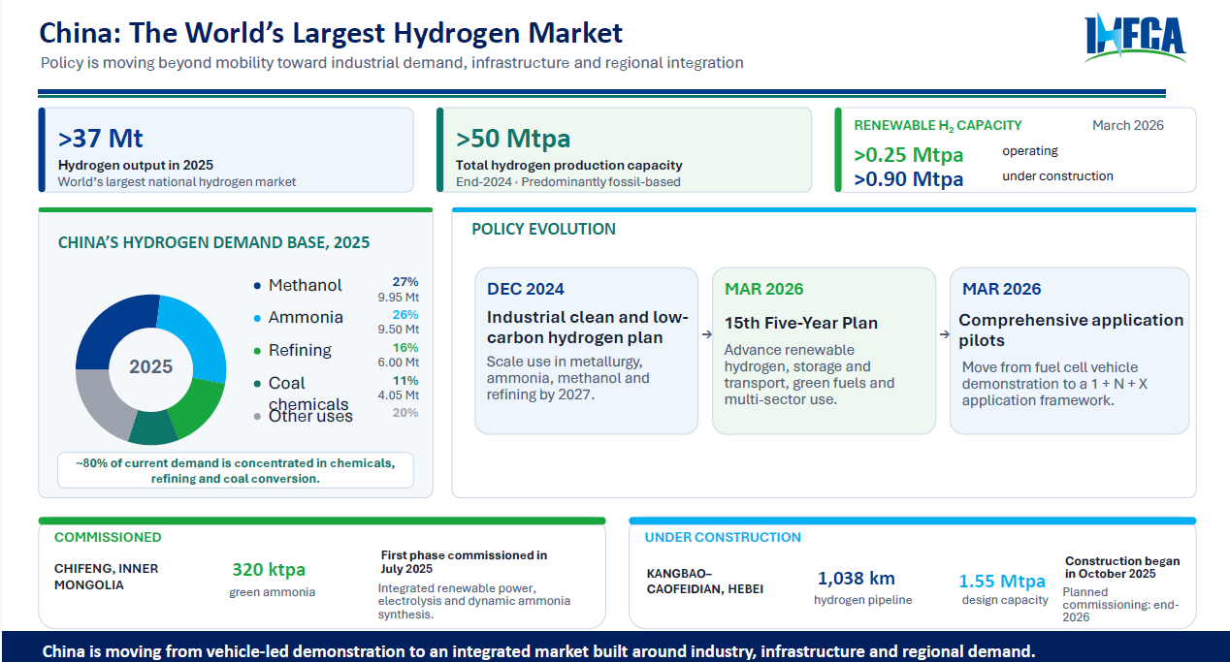
Notes:
This enhanced diagram shows the full energy logic of a Green Data Valley
This is not a speculative hydrogen vision. This is a practical system architecture that starts with curtailed wind, begins with resilience and backup, and scales into deeper system integration as hydrogen markets mature.
Surplus wind feeds electrolysis via private wire.
Hydrogen is stored and later converted back to power through fuel cells to support data centre operations, with optional grid interaction for resilience and market optimisation.
Grid is repositioned correctly
The grid is now shown as:
supportive, not dominant
a source of resilience and arbitrage
a beneficiary of flexibility and balancing
This visually reinforces the shift from grid load → grid asset.

Slide 51
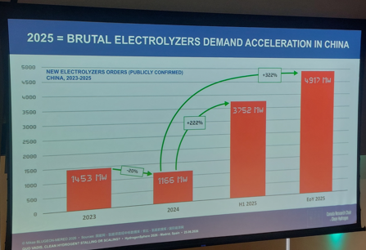
THE EUROPEAN UNION: REINFORCING GLOBAL IMPACT
CHINA
INTERNATIONAL HYDROGEN CLEAN FUELS ASSOCIATION (IHCFA)
Scaling Hydrogen Through Connected Ecosystems
IHFCA deepened cooperation:
UNIDO
World Bank
Hydrogen Council
IEA
ISO
GHIAA
Green Hydrogen India
COMESA and other international and regional organizations
Source: Hydrogen Sphere, June 2026
Notes:
Curtailment is not as a failure of renewables, but a system design issue.
Green Data Valleys treat curtailed energy as a strategic resource.

Slide 52
THE EUROPEAN UNION: REINFORCING GLOBAL IMPACT
CHINA
FORGING ALLIANCES AND ATTRACTING STRATEGIC INVESTMENTS
China stands as the world's second-largest economy
China is the EU’s third largest trading partner and EU-China engagement must lead to a level-playing field and a balanced, reciprocal and mutually beneficial relationship.
The EU seeks to promote its economic interests by advancing reciprocity, a level-playing field and fair competition between European and Chinese companies and exporters and by promoting European standards.
How is this translated into the Market? Is Europe sending the right message?
  Innovation Fund: The 25% Threshold for Chinese Electrolysers
  The Sourcing Cap: At least 75% of the electrolyser capacity (measured in MWe) included in a project must originate from countries outside of China. This means Chinese-manufactured electrolyser stack capacity is strictly capped at a maximum of 25%
Notes:
Curtailment is not as a failure of renewables, but a system design issue.
Green Data Valleys treat curtailed energy as a strategic resource.

Slide 53

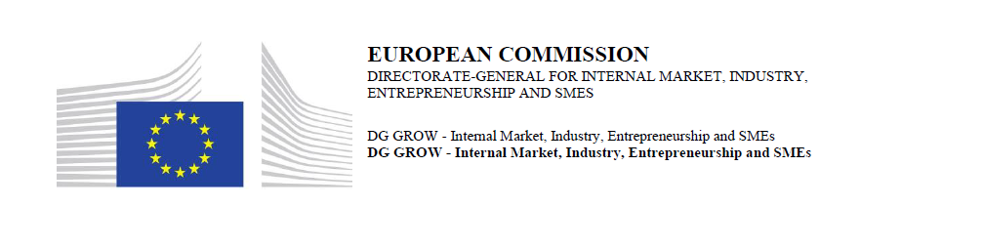
THE European energy mix:
THE ROLE OF NATURAL HYDROGEN
Natural Hydrogen.
Increasing Energy Security and Sovereignty in the EU
IEA – Technology Collaboration Programme (TCP)
Task 49 - Natural Hydrogen (April 2024)
TASK 49 brings together a worldwide Expert Committee to act jointly on research, exploration/production methods, evaluation of economic reserves, public policy, public acculturation, financing, infrastructures. a
Objective: to accelerate the exploration/production of natural H2 globally
Notes:
Reinforce the shift in mindset: data centres support system stability rather than threaten it.

Slide 54

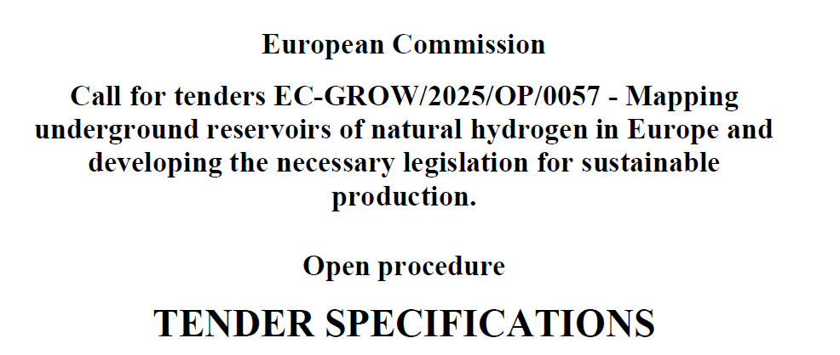
THE European energy mix:
THE ROLE OF NATURAL HYDROGEN
Natural Hydrogen.
Increasing Energy Security and Sovereignty in the EU
As a result of the PPPA Presented to the European Parliament in 2023/2024, the European Commission launched in July 2025 a Public TENDER to develop Regulation.
September 2023: Presented to the European Parliament a
Proposal of Preparatory Action (PPPA)
“Mapping underground reservoirs of natural hydrogen in Europe and developing the necessary legislation for sustainable production in the framework of the EU's Climate Law, the EU strategy on energy system integration, the European Economic Security Strategy and European Energy Sovereignty”
Objective:
Towards certification of natural hydrogen and increase market demand
Natural Hydrogen should be part of the European Energy Mi
Notes:
Reinforce the shift in mindset: data centres support system stability rather than threaten it.

Slide 55

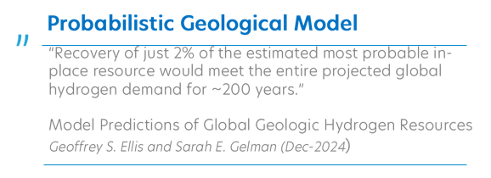

THE European Energy mix: THE ROLE OF NATURAL HYDROGEN
Global Resources Identified – Global Accumulation System
Notes:
Reinforce the shift in mindset: data centres support system stability rather than threaten it.

Slide 56
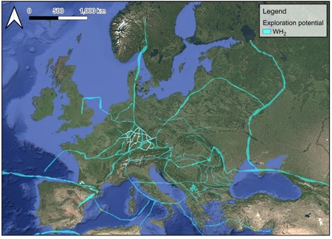
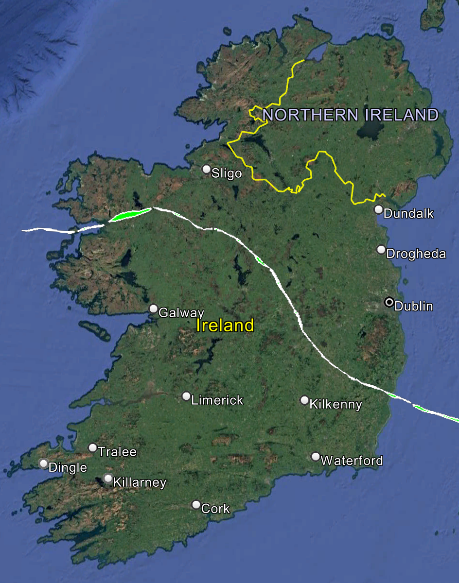
THE European Energy mix: THE ROLE OF NATURAL HYDROGEN
European Potential Identified– Accumulation System
Natural Hydrogen System in Ireland
A single WH₂ Field of 100 km³ could indicatively generate 800,000 to 2,000,000 recoverable hydrogen tons per year depending on the rechargeability rate.
Notes:
Reinforce the shift in mindset: data centres support system stability rather than threaten it.

Slide 57
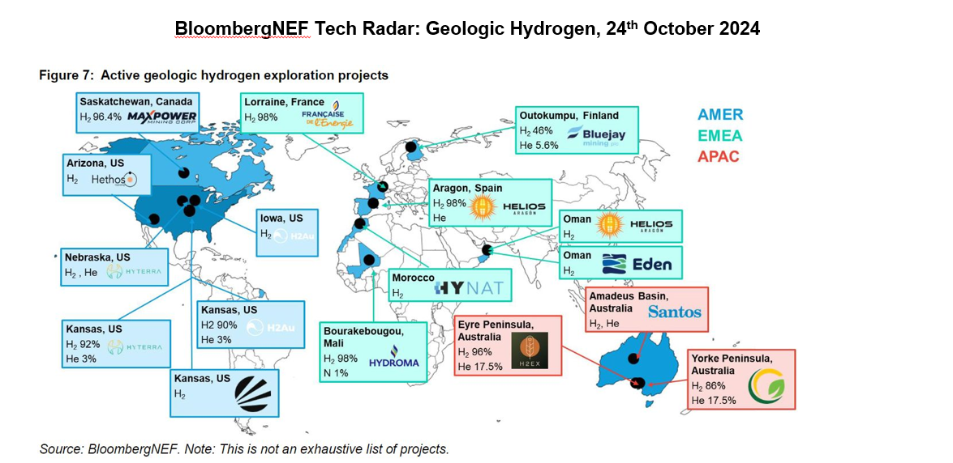
THE European Energy mix: THE ROLE OF NATURAL HYDROGEN
Some of the Companies active exploring for natural hydrogen
Notes:
Reinforce the shift in mindset: data centres support system stability rather than threaten it.

Slide 58
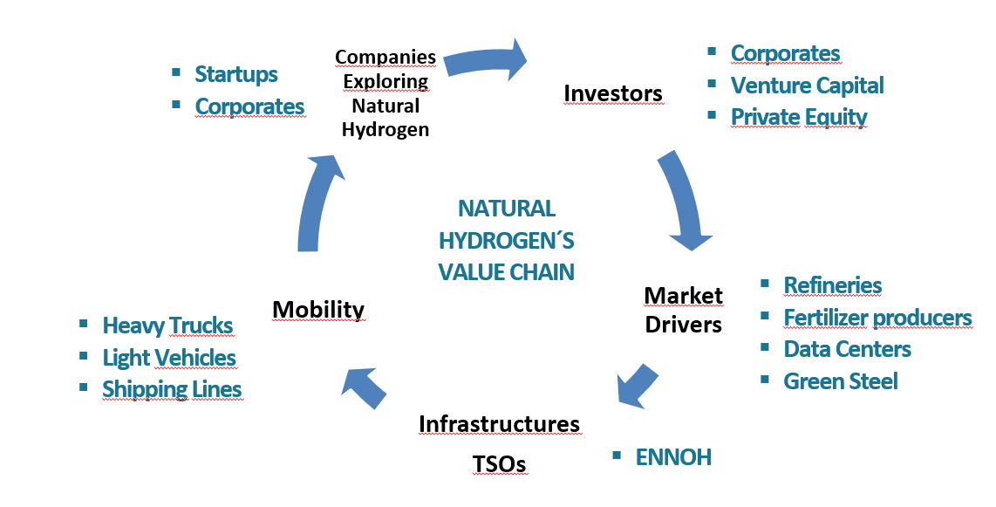
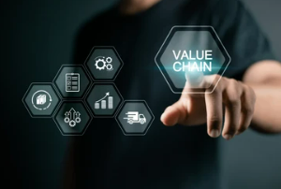
THE European Energy mix: THE ROLE OF NATURAL HYDROGEN
Natural Hydrogen in the Value Chain
Notes:
Reinforce the shift in mindset: data centres support system stability rather than threaten it.

Slide 59

THANK YOU!
Notes:
data centres shift from passive loads to active participants in energy systems.

Slide 60

CONCLUSION
Hydrogen at the Right Cost is a Shared Commitment
Hydrogen’s future will be defined not by how fast we move, but by how wisely we scale. Across technology, policy, society, and global partnership, the message is clear: progress must serve both people and planet. The right cost is not just financial — it’s ethical, environmental, and generational.
Hydrogen at the right cost is hydrogen done right — where innovation meets integrity, policy meets purpose, and investment meets inclusion. That is how we build a future powered by trust, not just technology.
Notes:
data centres shift from passive loads to active participants in energy systems.

Slide 61
4 key takeaways
Pillar | Core Message | Impact
1. Technology Pathways & Innovation | Innovation must deliver affordability and reliability without compromise. | Focus R&D on scalable, efficient systems that integrate renewables and reduce lifecycle emissions.
2. Policy, Regulation & Market Design | Smart policy builds confidence and accelerates fair competition. | Create frameworks that reward clean production, transparent certification, and cross-border cooperation.
3. Societal & Environmental Impact | Hydrogen must earn its social licence. | Engage communities early, measure benefits honestly, and ensure environmental safeguards are visible and trusted.
4. Global Partnerships & Strategic Investment | Collaboration is the multiplier of impact. | Align public and private finance to build resilient supply chains and equitable global hydrogen networks.
Notes:
Curtailment is not as a failure of renewables, but a system design issue.
Green Data Valleys treat curtailed energy as a strategic resource.

Slide 62
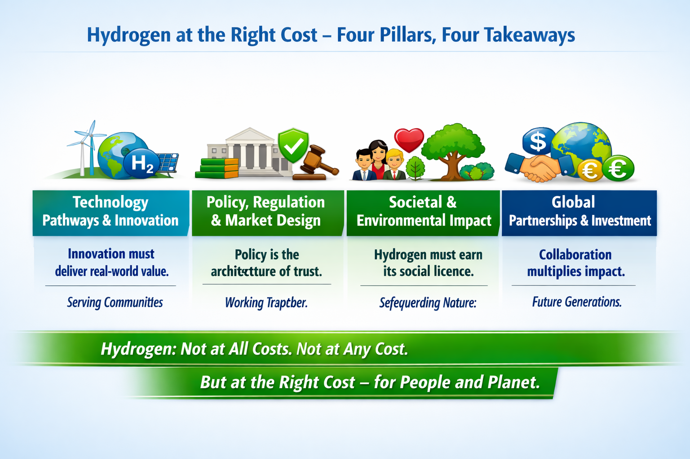

Slide 63
Hydrogen Ireland Calendar of Events 2026
2nd July Webinar
Clean hydrogen not at all costs, not at any cost but at the right cost - Host Pinsent Mason
10th September Webinar
Beyond the Grid: Clean Hydrogen Pathways for Data Centres - Host Bord Gáis
26th August Webinar
Hydrogen's role in delivery electricity security of supply for Ireland - Host ESB
14th October Workshop
Hydrogen Ireland 2026: Delivering Demand, Security and EU‑Aligned Deployment - Host GNI
18th -19th November International Conference
H₂ SUMMIT Securing Europe’s Energy Future - Hydrogen for Energy, Industry and Data Resilience in a Connected Europe - Host Hydrogen Ireland & Clean Hydrogen Partnership
Notes:
Ireland assumes the Presidency of the Council of the European Union from July to December 2026, and Hydrogen Ireland is preparing a coordinated programme of webinars, workshops, and our annual conference to align with this milestone and amplify Ireland’s hydrogen message to a global audience

