Slide 1
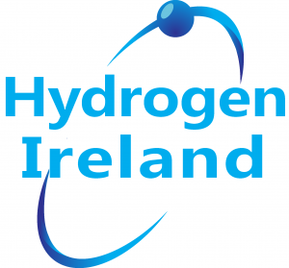
A Hydrogen Strategy for Ireland
The Association for Energy, Mobility, Industry & Community

Slide 2
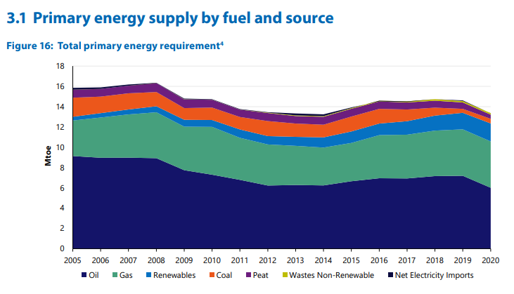
Ireland’s current energy system
The role of fossil fuels today
86% of Ireland’s energy needs are met by fossil fuels today*
Fossil fuels enable Ireland to transport and store energy
Energy security is met through fossil fuel storage
Fossil fuels mean Ireland has a reliable energy system. For example: they enable dispatchable electricity
Fossil fuels are used to power sectors that cannot be electrified
Fossil fuels enable an equitable energy system
This is the fuel that society is used to
The Association for Energy, Mobility, Industry & Community
Notes:
*SEIA report on Energy in Ireland 2021.

Slide 3
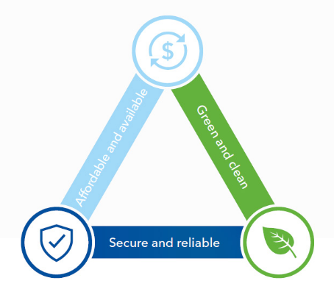
Energy System Transition
The energy trilemma requires systems thinking
Why we need to change
Europe’s policy in Energy System Integration requires for Ireland to consider the energy system as a whole.
Climate Action Bill commits Ireland to a 51% reduction in emissions by 2030.
Fossil fuels accounted for 57% of Ireland’s emissions. (SEIA Report)
Ireland needs to leverage successes in renewable electricity to decarbonise the whole energy system.
Ireland needs to overcome constraints on the electricity transmission network.
We need to capitalise on our wind natural resource, including 70GW offshore and become an energy exporter.
Indigenous Energy Storage requires Ireland to identify a new solution. (EU Policy)
Energy Equity
Environmental Sustainability
Energy Security
The Association for Energy, Mobility, Industry & Community
Notes:
Greater than 10K Turlough Hills required for energy storage.

Slide 4
Green Hydrogen enables Ireland’s energy transition
THE ENERGY SYSTEM OF 2050 WILL BE A RENEWABLE ELECTRICITY COMPLEMENTED BY GREEN HYDROGEN
Green Hydrogen can complement renewable electricity to meet all of Ireland’s energy needs.
Green Hydrogen can replace fossil fuels.
Green Hydrogen maximizes use of existing assets and infrastructure.
Green Hydrogen enables energy system integration.
Green Hydrogen enables Ireland to become a net exporter of energy.
Green Hydrogen meets Ireland’s energy storage and security needs.
Green Hydrogen will encourage clean industrial development in Ireland by supporting existing industries and attracting new ones.
Green Hydrogen can be used as a feedstock for fertilizer and other hydrogen-based products.
Green hydrogen is an energy vector that can help decarbonise the electricity grid in Ireland, and balance intermittency in wind, solar, and other renewable energy sources
Notes:
Carbon emissions from electricity production in Ireland reduced from 375 gCO₂/kWh in 2018 to 296 gCO₂/kWh in 2020, but was significantly higher in 2021 because of reduced wind energy generation during calm weather and unscheduled outages in natural gas fired plant, leading to use of coal fired generation to meet demand.
Hydrogen produced by electrolysis using hydropower, wind energy and solar energy is all classifiable as low carbon, defined in the current EU taxonomy as <3kgCO₂/kgH₂. Hydrogen produced by electrolysis using hydropower and wind energy is classified as ultra-low carbon <1kgCO₂/kgH₂

Slide 5
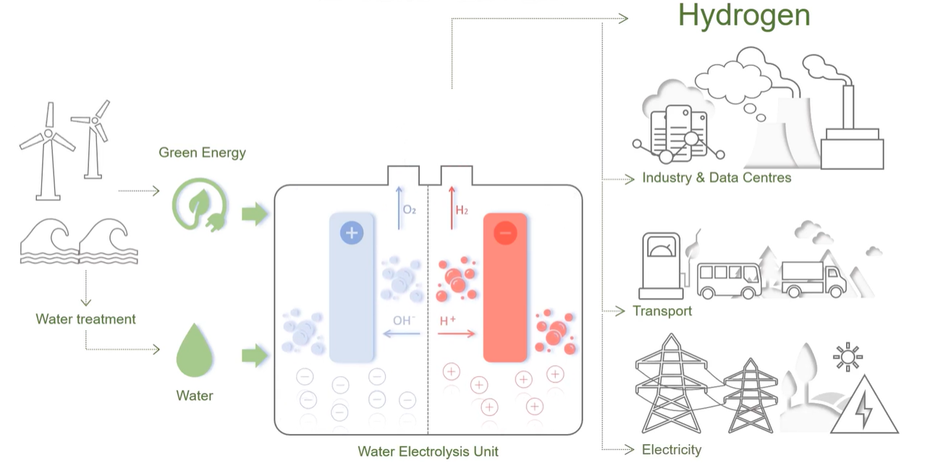
How Green Hydrogen is produced
The Association for Energy, Mobility, Industry & Community
Notes:
Confirmation of percentage to be confirmed by SEIA report.

